Slide 1
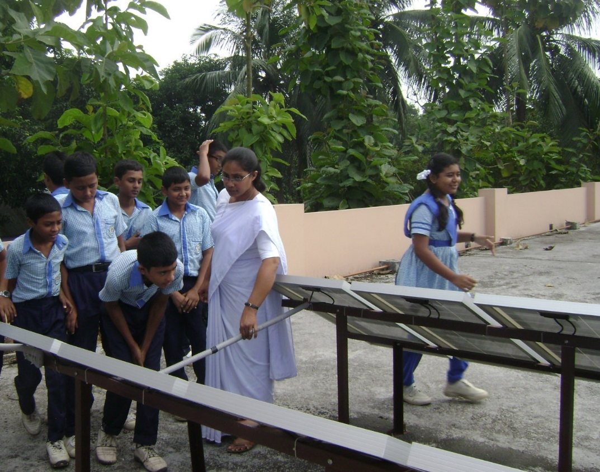
Carbon Footprint Reduction Fund (CFRF)
How the Sisters of the Holy Cross are responding to climate change
and care for creation.
Presented by Dana Taylor,
Asst. Justice Coordinator, Sisters of the Holy Cross /
Asst. Director, Holy Cross International Justice Office
Notes:
Greetings to all of you! It is a great pleasure to be with you today in spirit, if not in person.
I am Dana Taylor, Assistant Justice Coordinator for the Sisters of the Holy Cross and Assistant Director for the Holy Cross International Justice Office. Today, I am going to talk to you about the Sisters of the Holy Cross Carbon Footprint Reduction Fund, or the CFRF, as we call it. [next slide]

Slide 2
We will cover:
What the Catholic Church and the Congregation of the Sisters of the Holy Cross have to say about environmental degradation and climate change.
What the Carbon Footprint Reduction Fund (CFRF) is and why it was established.
An example of a funded project
Some things to consider when applying for the fund.
And, finally, how to apply.
Notes:
In our time together, we will look at:
What the Catholic Church and the Sisters of the Holy Cross have to say about environmental degradation and climate change
WHAT the CFRF is and WHY it was established
An example of a funded project.
Some things to consider when applying.
And FINALLY how to apply.
So, let’s begin by taking a look at Pope Francis’s most recent encyclical, Laudato Si’: On care for our common home, to understand how environmental degradation and climate change are viewed from the perspective of the Catholic Church.

Slide 3
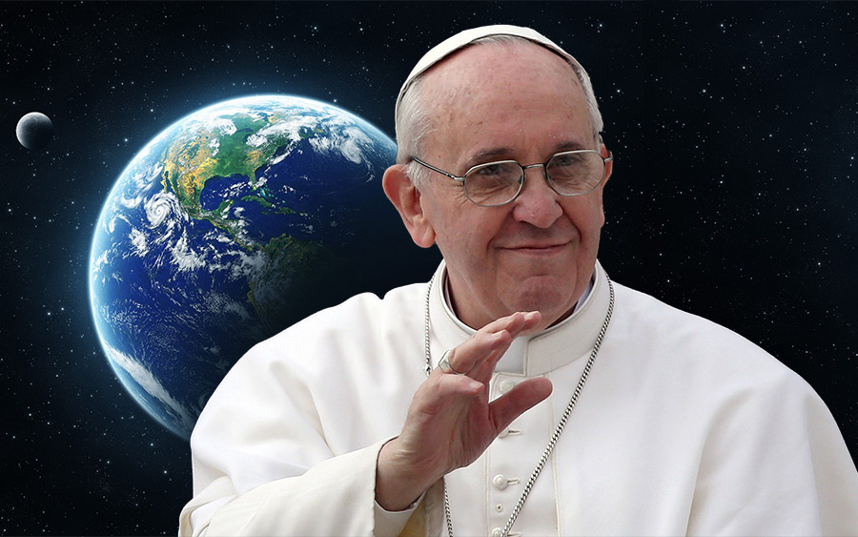
From Laudato Si’
The human environment and the natural environment deteriorate together;
we cannot adequately combat
environmental degradation
unless we attend
to causes related to
human and
social degradation. (48)
Notes:
On the issue of environmental degradation—that is, damage and deterioration of the environment due to the overuse of natural resources such as water, air, and soil; destruction of creation and extinction of beings; and pollution—Pope Francis declares:
The human environment and the natural environment deteriorate together; we cannot adequately combat environmental degradation unless we attend to causes related to human and social degradation. (48)
Basically, Pope Francis tells us that we have to approach justice from the basic understanding that neither we nor the problems we face exist in isolation, and so they cannot be solved in isolation. This invites us to recognize that, in order to serve the needs of the marginalized and excluded—people who are poor or have been made victims of war, forced migration and human trafficking—we must first help them to meet their basic needs, and this includes protecting the environment which sustains their lives. [next slide]

Slide 4
From Laudato Si’
The climate is a common good, belonging to all and meant for all. … a complex system linked to many of the essential conditions for human life. (23)
Notes:
Pope Francis also tells us that:
The climate is a common good, belonging to all and meant for all. … a complex system linked to many of the essential conditions for human life. (23)
[next slide]

Slide 5
From Laudato Si’
Climate change is a global problem with grave implications: environmental, social,
economic, political and for the distribution of
goods. It represents one
of the principal
challenges facing
humanity in our day. (25)
Notes:
On the issue of climate change, Pope Francis states that:
Climate change is a global problem with grave implications: environmental, social, economic, political and for the distribution of goods. It represents one of the principal challenges facing humanity in our day. (25)
So, again all justice issues are deeply connected-- a set of interconnected relationships with our Earth, Social, Cultural, and Economic systems, which Pope Francis refers to as integral ecology. I cover integral ecology in another video, but it is enough for now for you to recognize that we are morally bound to protect the climate and the environment, as part of our fundamental concern for the common good. [next slide]

Slide 6
Environmental Degradation
The congregation opposes
“actions and policies that legitimate…[d]egradation and destruction of natural resources and ecosystems.”
Corporate Stand on Nonviolence (2006)
Notes:
Now let’s look at how the Sisters of the Holy Cross have historically approached the issues of environmental degradation and climate crisis.
In taking the Corporate Stand on Nonviolence (2006), the Congregation publicly condemned all forms of violence, including “actions and policies that legitimate…[d]egradation and destruction of natural resources and ecosystems.” That is, the congregation rejects violence to Earth and all of creation. In this way, we see that our stance on peace and nonviolence inextricably connects with our commitment to care for creation. [Next Slide]

Slide 7
Environmental Degradation
Identifies links between “economic practices that create conditions that increase human vulnerability and enable human trafficking to flourish…[and] destruction of the environment which destroys sources of income and contributes to forced migration”
Corporate Stand Against Human Trafficking (2013)
Notes:
Seven years later, in the Corporate Stand Against Human Trafficking (2013), the Congregation identified the links between “economic practices that create conditions that increase human vulnerability and enable human trafficking to flourish” [and] “destruction of the environment which destroys sources of income and contributes to forced migration”. Again, we see that our work on trafficking cannot be separated from our work on nonviolence nor from our work on the care of creation. [Next Slide]

Slide 8
Family of Holy Cross Statement on Climate Change (2009)
Reduce energy consumption,
increase efficiency, and
employ renewable technologies to achieve carbon neutrality in our congregations by 2050.
Notes:
In 2009, the Congregation co-signed the Family of Holy Cross Statement on Climate Change. This public declaration commits the four congregations of Holy Cross to “reduce energy consumption, increase efficiency, and employ renewable technologies to achieve carbon neutrality in [their] congregations by 2050” AND [Next Slide]

Slide 9
Family of Holy Cross Statement on Climate Change (2009)
Ecological sustainability is integral to our congregational planning, decision-making, and practices.
Notes:
To “Ensure that ecological sustainability is integral to our congregational planning, decision-making, and practices.” [Next Slide]

Slide 10
Carbon Footprint Reduction Fund (CFRF)
General Leadership Team allocates $10,000 to CFRF annually
Plus, $15 per metric tonne of GHG emitted for all General Level travel annually
External donations
Notes:
A major initiative that concretely and comprehensively addresses these concerns is the Carbon Footprint Reduction Fund, established by the General Leadership Team in May 2014. Each year the General Leadership Team allocates $10,000 (US) to this fund, as well as $15 per metric tonne of carbon that is emitted due to travel at the General Level. This includes travel by the Leadership Team members, members of congregational committees, and congregation staff. External donations are also accepted through the Development Office. [Next Slide]

Slide 11
Carbon Footprint Reduction Fund (CFRF)
Projects increase energy efficiency and decrease dependence on fossil-fuels, and/or deforestation in local communities and sponsored ministries.
Notes:
Each spring, Sisters may apply to the Congregation Justice Office, for grants that support projects which increase energy efficiency and decrease dependence on fossil-fuels, and/or deforestation in local communities and sponsored ministries. These applications are submitted to and processed by me, on behalf of the Congregation Justice Office, and reviewed by a committee to ensure that they meet necessary criteria. Finally, the recommendations are submitted to General Leadership for consideration. [Next slide]

Slide 12
What kinds of projects do we fund?
Renewable energy projects (solar, wind, hydro, geothermal and biofuels)
Tree planting and re-forestation projects
Energy-efficiency projects (LED light replacements)
We prioritize those projects with the greatest impacts (e.g. carbon-reduction, educational, general wellbeing and health impacts.)
Notes:
So, again, we will fund projects that create opportunities for:
Renewable energy (such as solar, wind, hydro, geothermal, and biofuels)
Tree planting and re-forestation AND
Energy-efficiency (LED light replacements)
We prioritize those projects with the greatest impacts. For example, we are interested in impacts such as carbon reductions, educational opportunities, general wellbeing and/or added health benefits.

Slide 13
Carbon Footprint Reduction Fund (CFRF)
Between 2015 and 2018 grant years:
34 projects; 7 countries; More than $60,000
e.g. solar power installations,
solar lights and refrigerator for healthcare,
tree planting
Notes:
Between the grant years 2015 through 2017, 24 projects have been funded in 6 countries, with awards totaling more than $41,000. Projects have included solar power installations in schools and convents, solar powered lighting and refrigeration in health centers, and several tree planting projects. Many of the tree planting projects have been very creative, generating fresh fruits for convents and schools, as well as creating spaces for communal gatherings. So, let’s take a look at one of these projects in more detail to better understand how such work is not only addressing climate change but also creating authentic human development. [Next slide]

Slide 14
Solar: School and convent, Bhadun
Solar power to both convent and Moreau Holy Cross School
An educational opportunity
Notes:
Solar project: School and convent building, Bhadun In Bangladesh, Sister Catherine Konica Sarkar received full funding for a solar power installation project that provided service to both Moreau Holy Cross School and the convent. At the end of the project, Sister also educated her sixth grade students extensively on how solar energy works and what equipment is necessary and why. Most importantly, perhaps, the students were taught how renewable energy use reduces reliance on fossil-fuels and decreases the greenhouse gas emissions that contribute to climate change.
[Next Slide]

Slide 15
Solar: School and convent, Bhadun
Education about sustainable development is critical, especially in places most vulnerable to the consequences of climate change.
Women and children suffer disproportionately.
Notes:
We believe that such education is critical in countries throughout the world that very much need development, but which are particularly vulnerable to the impacts of climate change. Bangladesh, for example, regularly experiences the stress of climate change and rising water levels, which result in significant land loss. This in turn presents serious food security issues and severely threatens the economy. Scarcity promotes conflict and violence and leaves poor and marginalized people desperate and vulnerable to labor exploitation and trafficking. And as we know, women and children suffer most profoundly under these conditions. [Next Slide]

Slide 16
Solar: School and convent, Bhadun
The pressure to develop is often accompanied by the displacement of traditional cultural values, in favor of consumerism, which is typically associated with high social status.
Again, we must encourage authentic development.
Notes:
Unfortunately, the pressure to develop is also often accompanied by the displacement of traditional cultural values, in favor of individualistic consumerism, which is typically associated with high social status. Consumerism drives us to accumulate and waste more “STUFF” so that we look and feel prosperous in the eyes of others. So this is incredibly problematic. We need to foster development certainly, but it must be authentic development, which causes NO HARM to present or future generations. [Next Slide]

Slide 17
Solar: School and convent, Bhadun
“[The students] are also happy because, during the cloudy days, they get light in the classrooms.”
“Sisters in the convent are [benefitting] by the solar lights in the convent building….the chapel looks very bright, and sisters have no difficulty praying from the book.”
Notes:
Getting back to our solar project in Bangladesh, we can see that this work is likely to have positive impact for the foreseeable future, and who knows how many future engineers Sister Konica has inspired! Sister’s report on how this project has touched the lives of sisters and students alike says it better than I can.
Sister Konica reported that: “[The students] are also happy because, during the cloudy days, they get light in the classrooms.” AND “Sisters in the convent are [benefitting] by the solar lights in the convent building….the chapel looks very bright, and sisters have no difficulty praying from the book.”
Not only are the Sisters in Bangladesh setting a good example of how to develop in a morally responsible way, with renewable energy, they are also witnessing dynamic impacts in the way people live their lives, through these seemingly small projects.
Are you feeling inspired? Okay, let’s look at some of the things you might consider when applying for the CFRF. [Next Slide]

Slide 18
Things to consider when applying
Estimates must be gathered for any labor or supplies that will be needed for your project.
Consider what kinds of impacts you expect your project to have on your local community and beyond.
How will you maintain your project after the grant year has ended? How will you meet the necessary financial or labor obligations to keep your equipment or plantings in good order?
Notes:
Well, first, since this is a reimbursement grant, you will want to gather estimates for any labor or supplies that will be needed for your project.
In writing a good application, you will want to consider what kinds of impacts you expect your project to have on your local community and beyond. So think about the many benefits your proposed project could have.
Now, whether you are installing new equipment or planting trees, there will be some future cost of maintaining your project after the grant year has ended. How will you meet the necessary financial or labor obligations to keep your equipment or plantings in good order? [Next Slide]

Slide 19
Things to consider when applying
Awards are typically around $2,500 USD per project (though some have been greater), so:
If your project involves construction, you might think about breaking work up into phases that could be completed in subsequent grant years. You might want to indicate this hope on your application.
Funded phases or projects must be completed within the grant year (July 1 to June 30).
Notes:
Most of our projects have received about $2,500 USD for a grant year, though we have awarded more in some cases.
So what should you do if, for example, you want to install solar panels and a great deal of construction or labor will be involved? Well, you might think about breaking this work up into phases that could be completed in subsequent grant years, as many of our sisters have done. If you are planning on working in phases, it would be a good idea to indicate this on your current application.
And, finally, funded phases or projects must be completed within a given grant year (July 1 to June 30). So you don’t want to plan for more work than can be completed within that time.
Know that, at any time, you can contact me in the Congregation Justice Office for help, and I will do my best to support you in this process. [Next Slide]

Slide 20
CFRF, Integral Ecology, and Authentic Development
Distributive justice
Reducing pressures associated with scarcity
Creating/sustaining new markets
Inspiring youth for a brighter tomorrow
Creating a new story and a new world
Notes:
First and foremost, the Carbon Footprint Reduction Fund is one important way in which the Congregation actively cares for creation.
But the Congregation is also contributing to distributive justice, by redistributing and sharing resources where they can do the most good. That is, we calculate the environmental cost of necessary travel, and we use those funds to reduce greenhouse gas emissions around the world. This simultaneously reduces the pressures associated with scarcity which in turn promote conflict.
We are creating and sustaining local economic markets for renewable energy in the places we live and serve. In essence, we are creating the cultural, political, and financial will to develop in a manner which harms none, least of all creation.
We are inspiring young hearts and minds. We are, in fact, bringing a new story and a new world into being.
[Next Slide]

Slide 21
Questions? Comments?
Contact Dana Taylor at dtaylor@cscsisters.org
Let us close here, with the words of Pope Francis …
Notes:
Thank you for watching this video and for your commitment to justice and the care of creation. Your feedback and questions are welcome at any time.
Let us close here today, with the words of Pope Francis. [Next Slide]

Slide 22
May our struggles and our concern for this planet never take away the joy of our hope.
God, who calls us … to give him our all, offers us the light and the strength needed to continue on our way …
and his love constantly impels
us to find new ways forward.
Praise be to him!
Laudato Si’(244-245)
Notes:
May our struggles and our concern for this planet never take away the joy of our hope.
God, who calls us … to give him our all, offers us the light and the strength needed to continue on our way … and his love constantly impels us to find new ways forward. Praise be to him!
[END SHOW]

