Slide 1
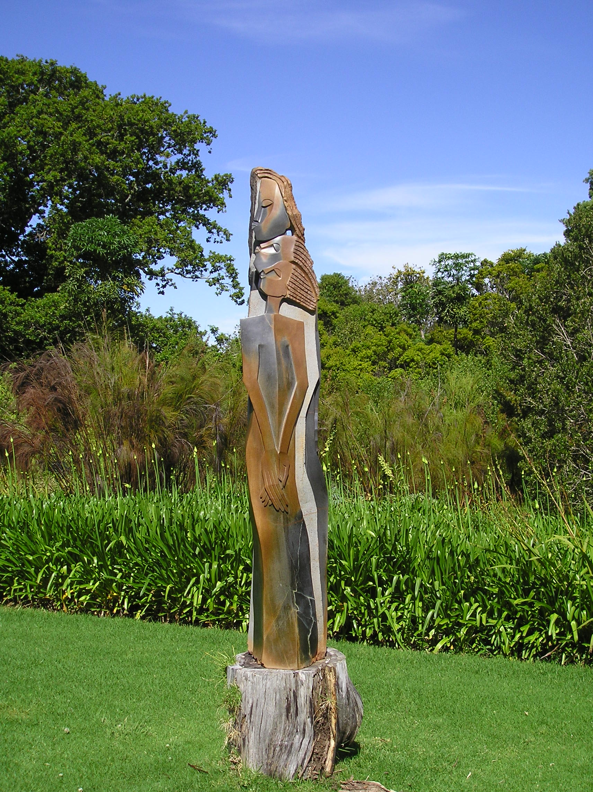
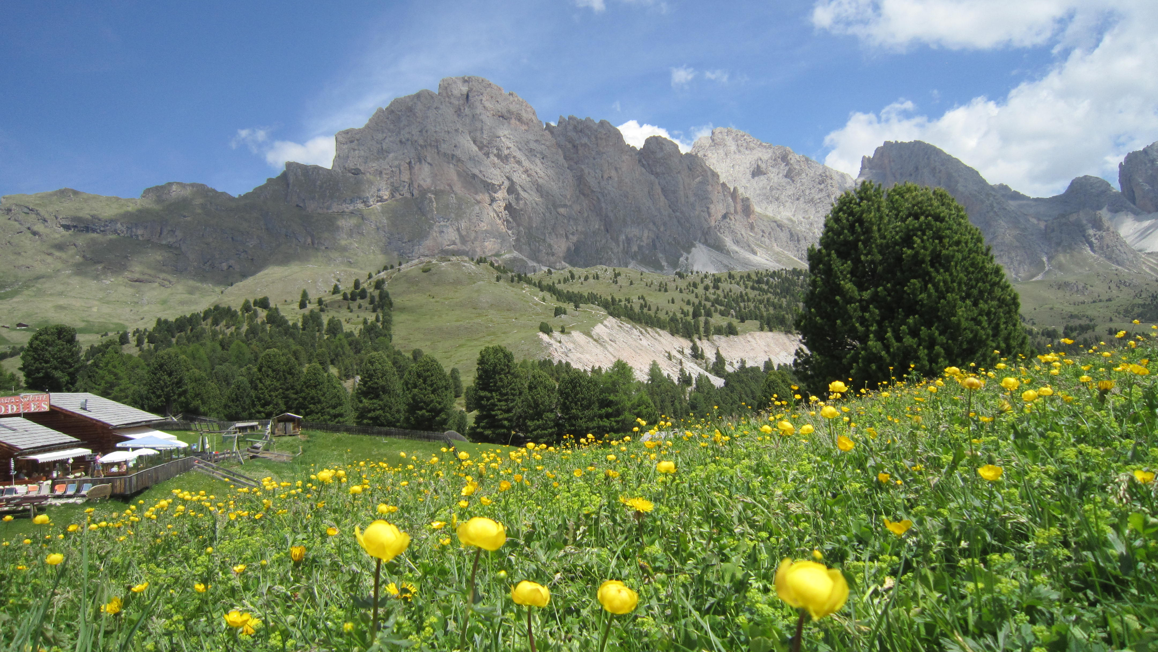
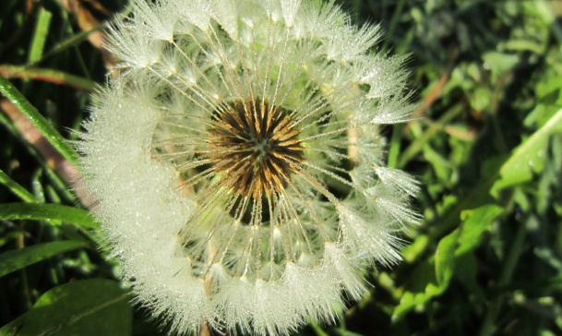
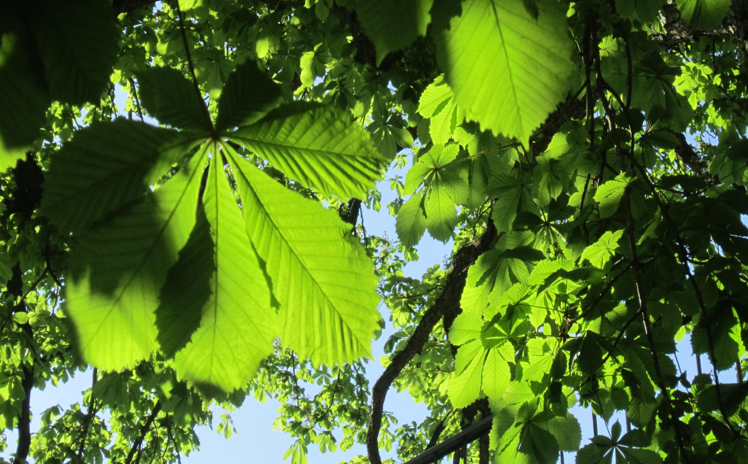
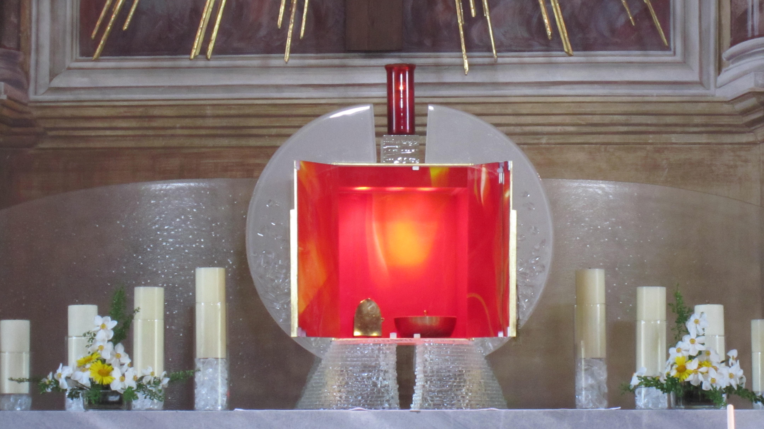
Season of Creation
With texts from Pope Francis‘ encyclical Laudato Si
Ecological conversion – a Christian Duty
Love of little Things
Serene Attentiveness
The Eucharist –
the great Thanksgiving of Creation
Creation – a Reflection of the Trinity

Slide 2
Ecological conversion - A christian duty
ECOLOGICAL CONVERSION – A CHRISTIAN DUTY
Integrity of creation, the protection of the environment, to live in harmony with nature: these are not hobbies of some exotic freaks. They are part and parcel of our faith in a God who has entrusted his creation to us in order to ‘cultivate it and care for it’.
Our care for creation must not remain a pious thought, or an academic discussion.
Prayer
All-powerful God, Bring healing to our lives,
that we may protect the world and not prey on it,
that we may sow beauty, not pollution and destruction.
Teach us to discover the worth of each thing,
to be filled with awe and contemplation,
to recognize that we are profoundly united
with every creature
as we journey towards your infinite light. _{LS 246}

Slide 3
Ecological conversion - A christian duty
ECOLOGICAL CONVERSION – A CHRISTIAN DUTY
Some texts from Pope Francis‘ encyclical Laudato Si
Living our vocation to be protectors of God’s handiwork
is essential to a life of virtue;
it is not an optional or a secondary aspect of our Christian experience. LS 217
This conversion calls for a number of attitudes:
gratitude and gratuitousness… a recognition that the world is God‘s loving gift… generosity in self-sacrifice. As believers, we do not look at the world from without but from within, conscious of the bonds with which the Father has linked us to all beings. LS 220
The ecological conversion needed to bring about lasting change
is also a community conversion. LS 219
An ‘ecological conversion’
must shape our daily decisions and relationships.

Slide 4
" The ideal is not only to pass from the exterior
to the interior to discover the action of God in the soul,
but also to discover God in all things.“ LS 233

Slide 5
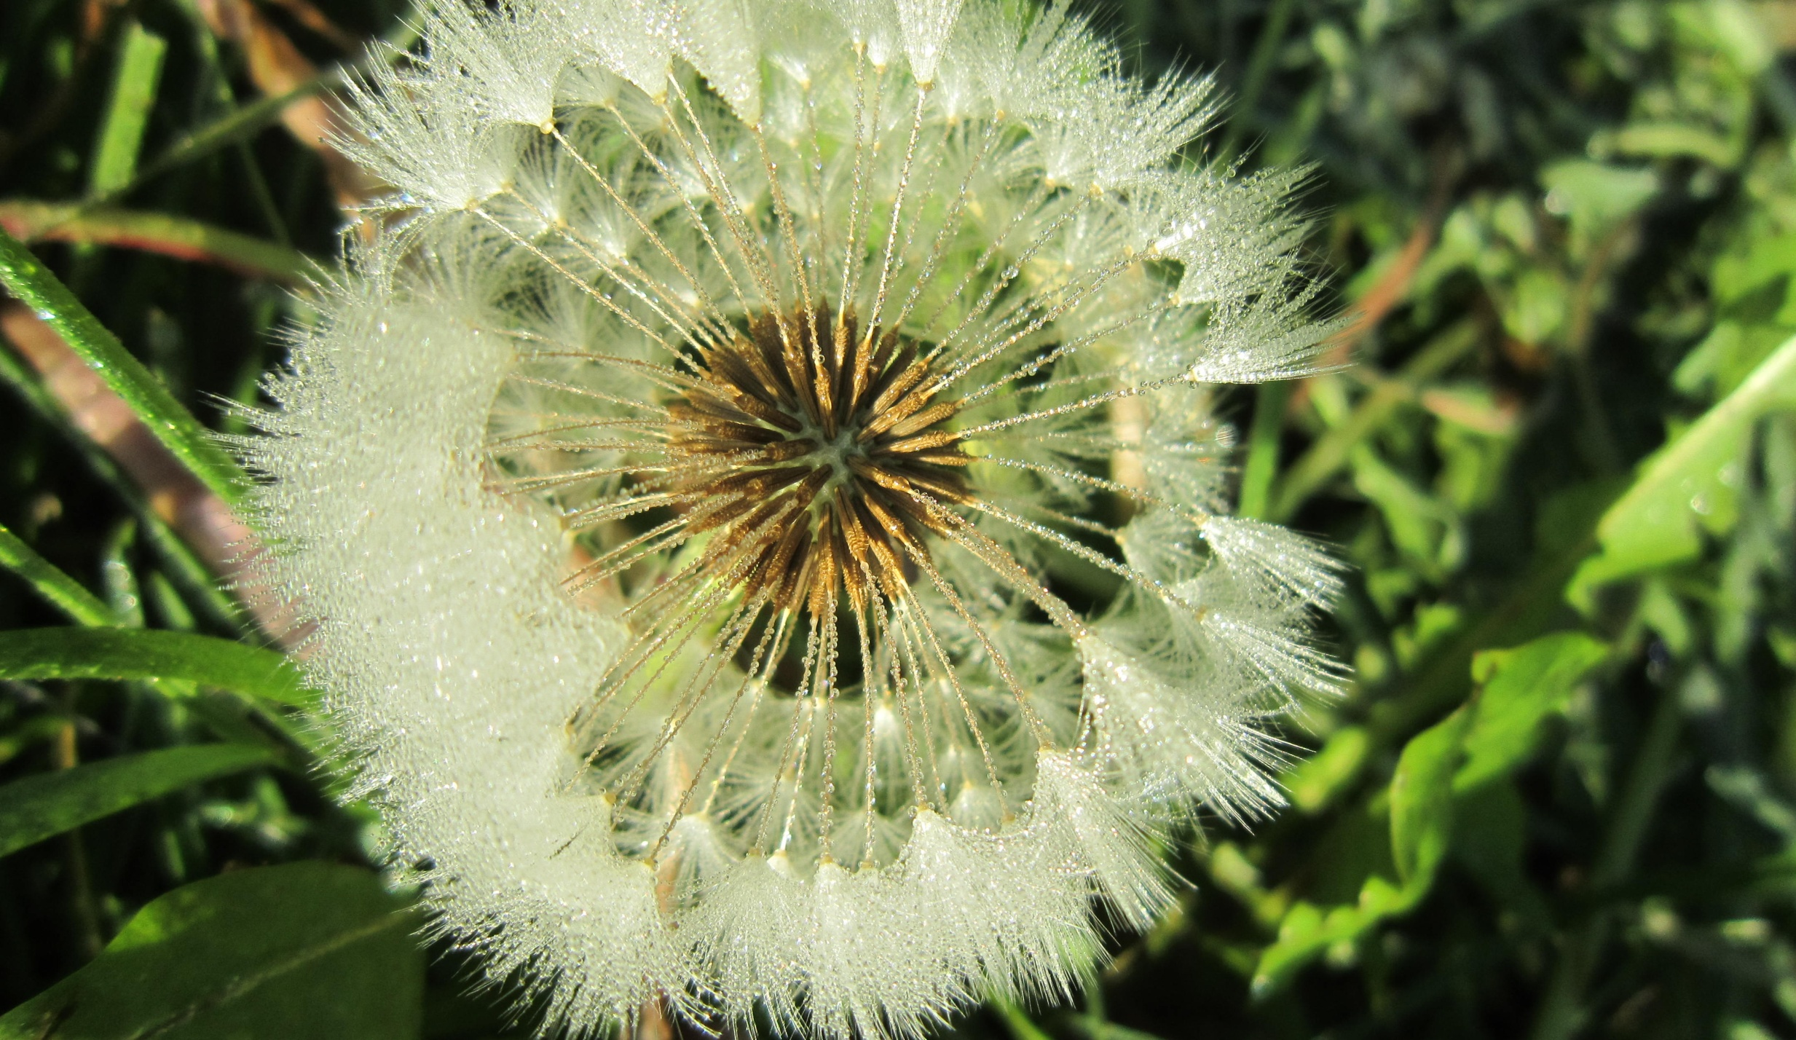

LOVE OF LITTLE THINGS
St. Therese of Lisieux has taught us how to walk in the ‘little way’ of love. Similarly, Pope Francis stresses the importance of the simple gestures and small daily decision to achieve an ‘integral ecology’.
They restore to our lives a sense of dignity and value, just as God has given even to the tiniest creature a unique beauty and an infinite value.
Prayer
All-powerful God, you are present in the whole universe and in the smallest of your creatures.
You embrace with your tenderness all that exists.
Pour out upon us the power of your love,
hat we may protect life and beauty.

Slide 6
LOVE OF LITTLE THINGS
Some texts from Pope Francis‘ encyclical Laudato Si
Every creature is thus the object of the Father’s tenderness,
who gives it its place in the world. Even the fleeting life of the least of beings is the object of his love, and in its few seconds of existence, God enfolds it with his affection. LS 77
Each creature possesses its own particular goodness and perfection … LS 69
There is a nobility in the duty to care for creation
through little daily actions… LS 211
Saint Therese of Lisieux invites us
to practise the little way of love,
not to miss out on a kind word, a smile or any small gesture which sows peace and friendship. An integral ecology is also made up of simple daily gestures which break with the logic of violence, exploitation and selfishness. LS 230

Slide 7

"All-powerful God, you are present in the whole universe
and in the smallest of your creatures.
You embrace with your tenderness all that exists.
Pour out upon us the power of your love,
hat we may protect life and beauty.“ LS 246

Slide 8
SERENE ATTENTIVENESS
Attentiveness and mindfulness are buzz words these days.
Managers are initiated to practice it in order to be more relaxed and efficient in their work.
For Pope Francis attentiveness is a fundament attitude of the heart,
an expression of love and a way to overcome an unhealthy.
Prayer
God of love, show us our place in this world
as channels of your love
for all the creatures of this earth,
for not one of them is forgotten in your sight.

Slide 9
SERENE ATTENTIVENESS
Disinterested concern for others,
and the rejection of every form of self-centeredness and self-absorption, are essential if we truly wish to care for our brothers and sisters
and for the natural environment. LS 208
We are speaking of an attitude of the heart,
one which approaches life with serene attentiveness,
which is capable of being fully present to someone
without thinking of what comes next,
which accepts each moment as a gift from God to be lived to the full… (Jesus) was completely present to everyone and to everything,
and in this way he showed us the way to overcome that unhealthy anxiety which makes us superficial, aggressive and compulsive consumers.. LS 226
Along with the importance of little everyday gestures,
social love moves us to devise larger strategies
to halt environmental degradation and to encourage
a ‘culture of care’ which permeates all of society. LS 231

Slide 10
“We are called to include in our work
a dimension of receptivity
and gratuity,
which is quite different
from mere inactivity.“ LS 237

Slide 11
THE EUCHARIST – THE GREAT THANKSGIVING OF CREATION
Vatican Council spoke of the Eucharist as celebration of the sacrifice of Jesus,
as the sign of the unity of the church and as the summit of Christian life.
Pope Francis enriches our understanding of the mystery of faith through an unusual aspect that reminds us of Teilhard de Chardin:
“the Eucharist as an act of cosmic love
that embraces and penetrates the whole of creation”.
Prayer
Through him , with him ,
in him in the unity of the Holy Spirit,
all glory and honour is yours,
Almigthy Father, for ever and ever.

Slide 12
THE EUCHARIST – THE GREAT THANKSGIVING OF CREATION
It is in the Eucharist that all that has been created finds its greatest exaltation. … it is the living centre of the universe,
the overflowing core of love and of inexhaustible life.
Joined to the incarnate Son, present in the Eucharist,
the whole cosmos gives thanks to God.
Indeed the Eucharist is itself an act of cosmic love:
“Yes, cosmic!
Because even when it is celebrated on the humble altar of a country church, the Eucharist is always in some way celebrated on the altar of the world”.
The Eucharist joins heaven and earth;
it embraces and penetrates all creation.
The world which came forth from God’s hands
returns to him in blessed and undivided adoration…
Thus, the Eucharist is also a source of light and motivation
for our concerns for the environment,
directing us to be stewards of all creation. LS 236

Slide 13
"The day of rest,
centred on the Eucharist,
sheds it light on the whole week,
and motivates us
to greater concern
for nature and the poor.“ (LS 237)

Slide 14
CREATION – A REFLECTION OF THE TRINITY
For most Christians the Trinity is a difficult truth.
For Pope Francis, the Trinity is the key to understanding the world and ourselves. God is relationship. All creatures strive to relate to others.
The human person grows to maturity through relating to God,
to others and to all creatures.
Prayer
O Triune Lord, wondrous community of infinite love,
teach us to contemplate you in the beauty of the universe,
for all things speak of you.
Awaken our praise and thankfulness
for every being that you have made.
Give us the grace to feel profoundly
joined to everything that is.

Slide 15
CREATION – A REFLECTION OF THE TRINITY
The Trinity has left its mark on all creation… Each creature bears in itself a specifically Trinitarian structure. LS 239
In this way, they make their own that Trinitarian dynamism
which God imprinted in them when they were created. LS 240
It is proper to every living being to tend towards other things. This leads… to discover a key to our own fulfilment. The human person grows more, matures more and is sanctified more to the extent that he or she enters into relationships, going out from themselves to live in communion with God, with others and with all creatures.
The divine Persons are subsistent relations,
and the world, created according to the divine model,
is a web of relationships…

Slide 16
“Triune Lord,
wondrous community
of infinite love,
teach us to contemplate you in the beauty
of the universe,
for all things speak of You.."
LS 246

Slide 17
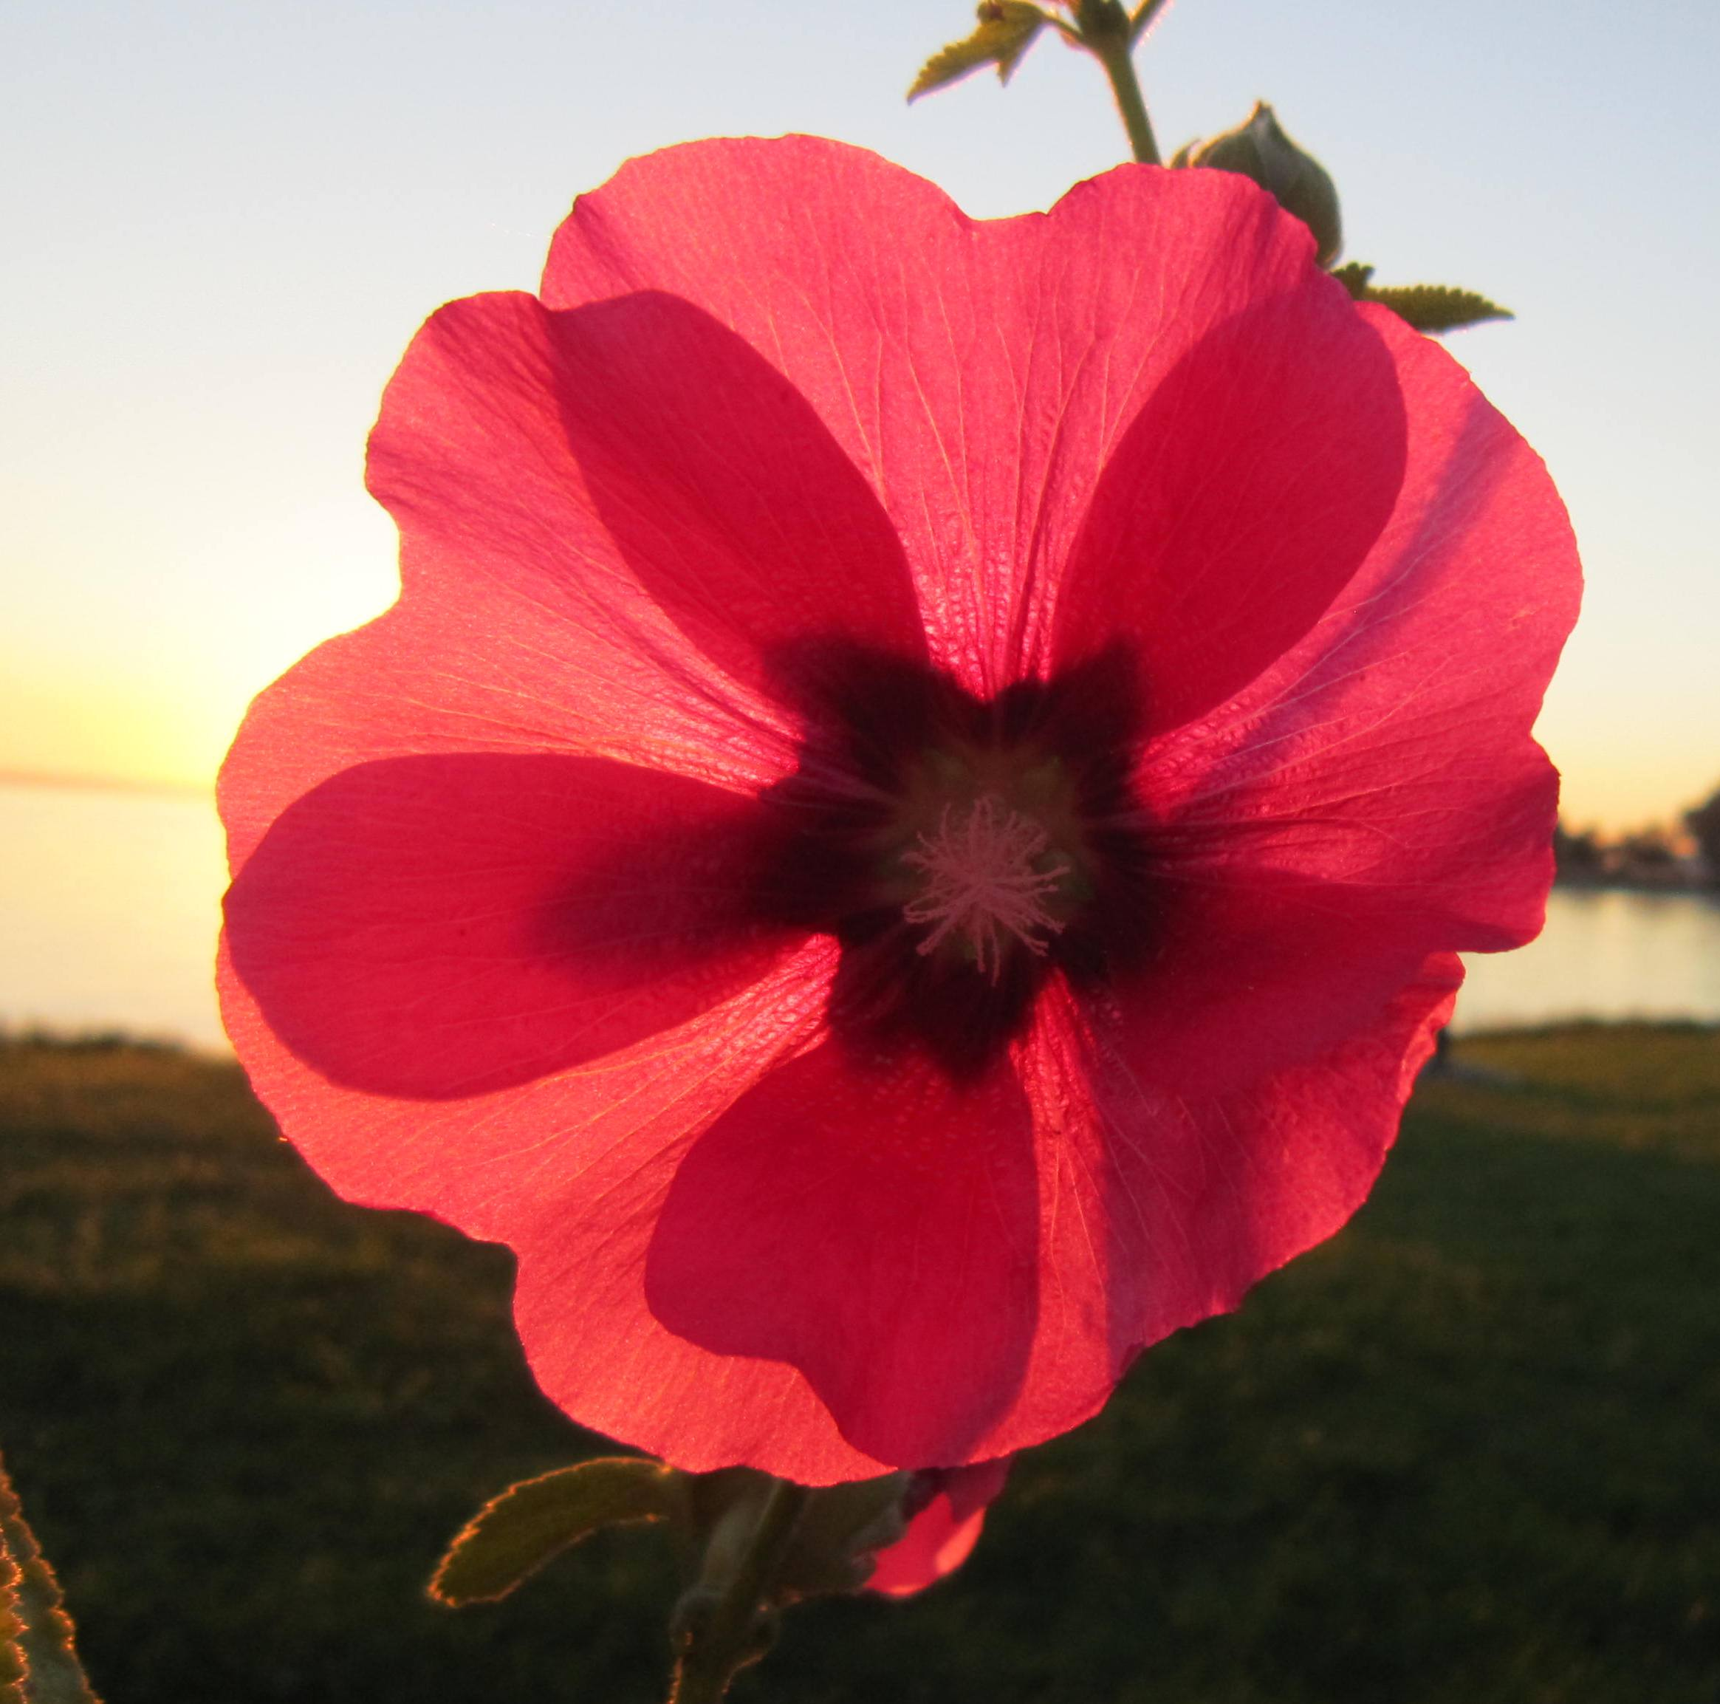

Text and Pictures
Sr. Ingrid Geissler cps
AEFJN/
NAD
53113 Bonn
Sträßchensweg 3
Tel. 0228 18471660
nad.bonn@netzwerkafrika.de
Sträßchensweg 3
Tel. 0228 18471660
http://www.netzwerkafrika.de/
mailto:nad.bonn@netzwerkafrika.de

