Slide 1
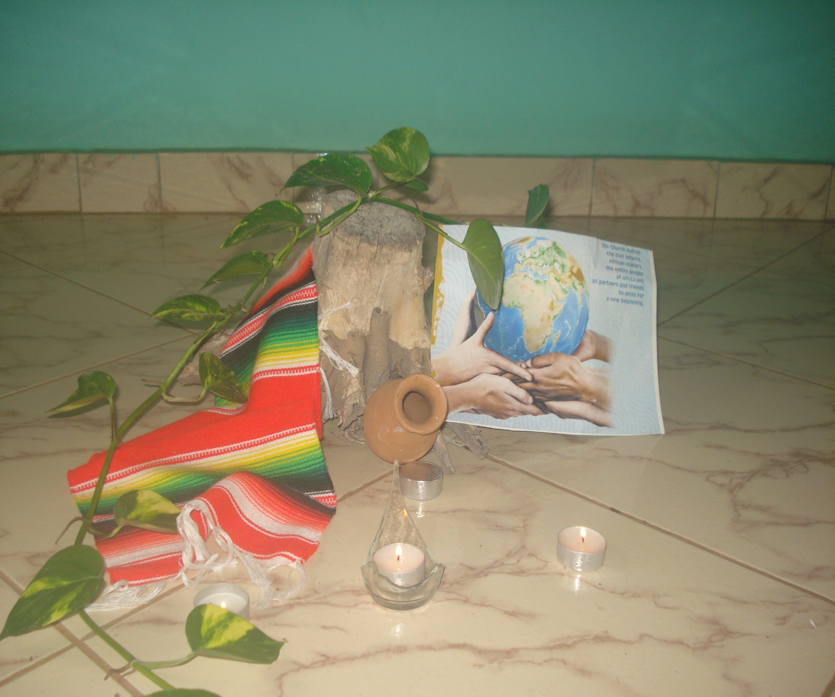
SEASON
OF
CREATION

Slide 2
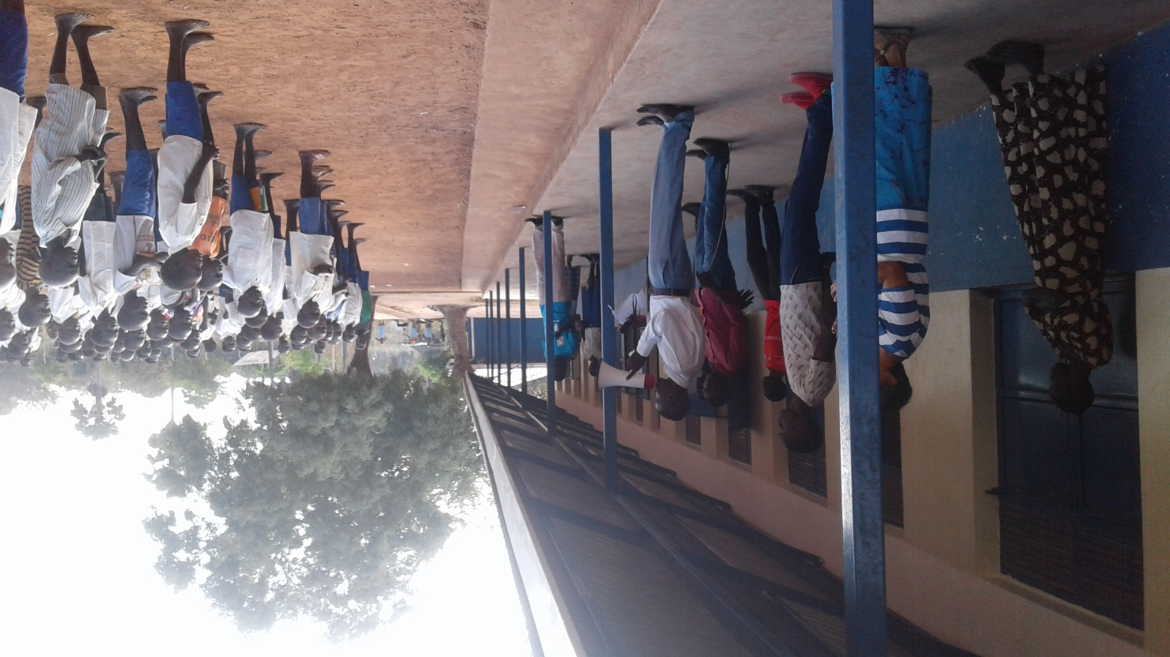
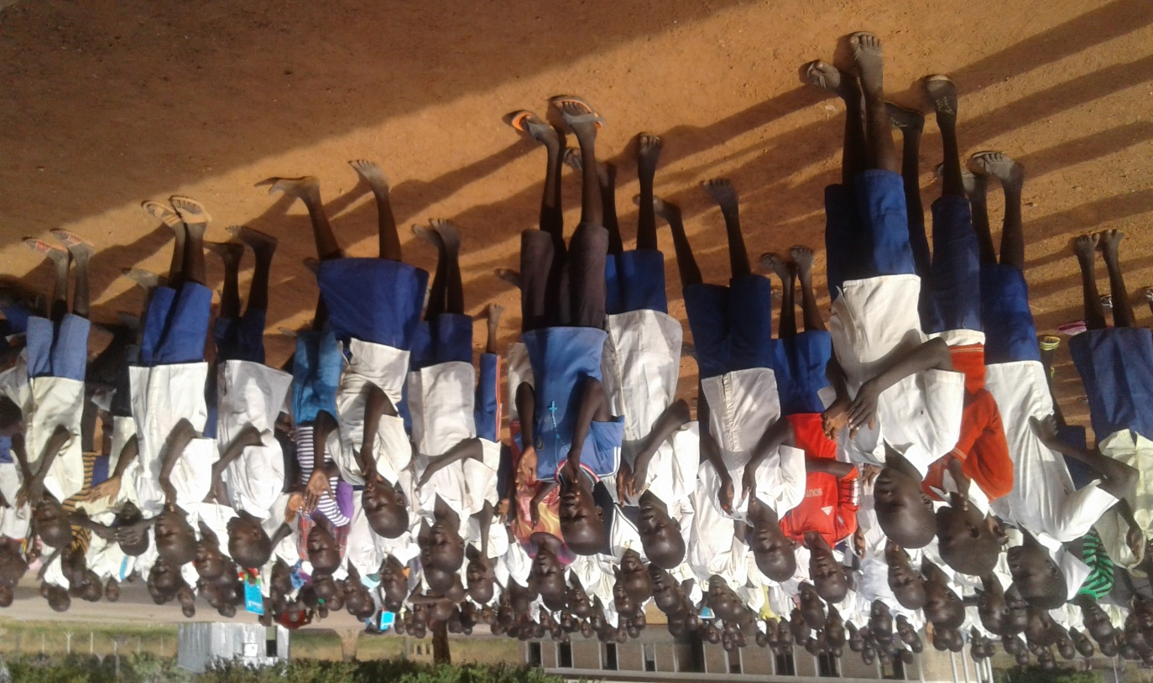
Climate Change
Prayer and awareness of climate change
In Achol Malek Primary School – Gok State

Slide 3
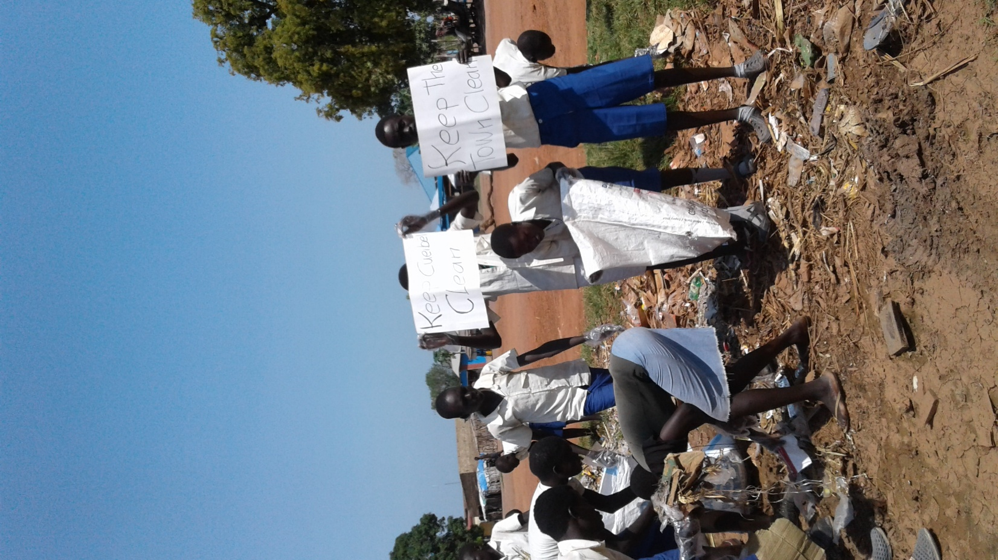
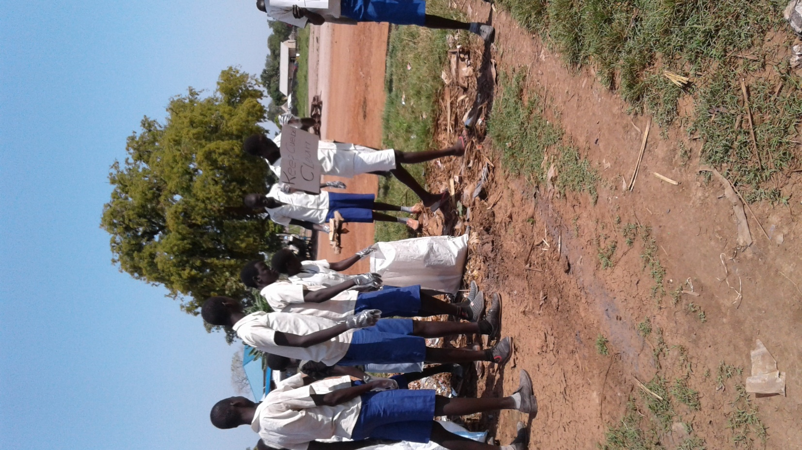
Call for
Action
On
Climate
Change

Slide 4
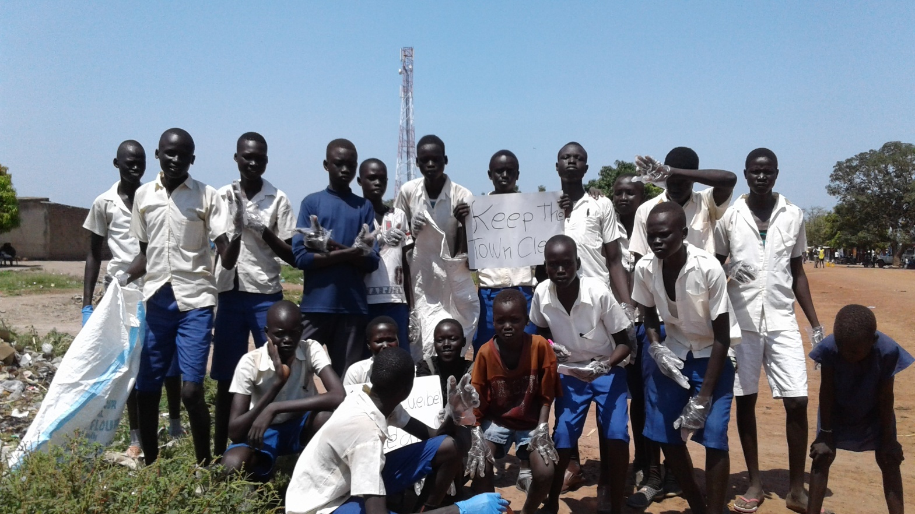
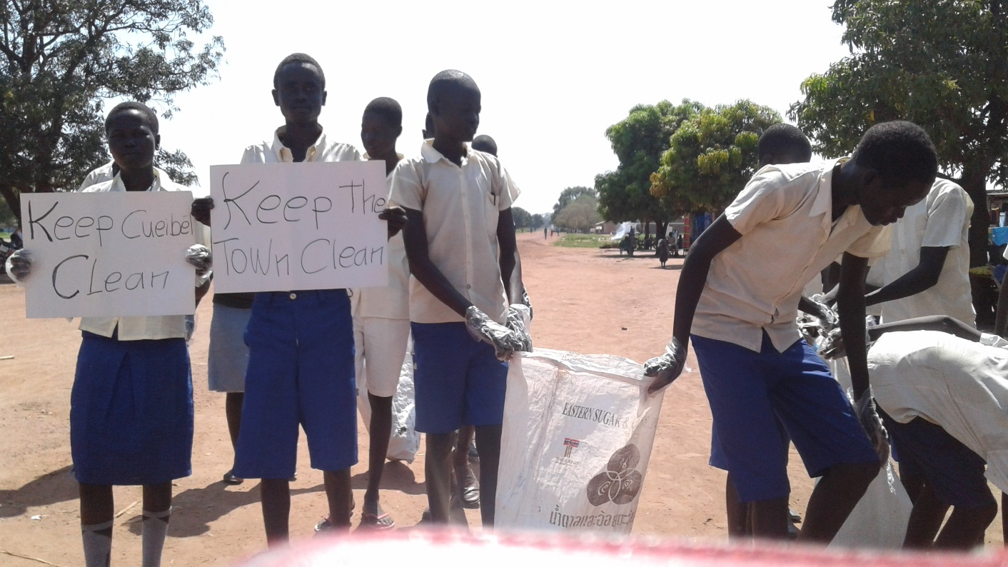
Environmental club
In
Action
Members of Enviromental
club cleaning the town

Slide 5
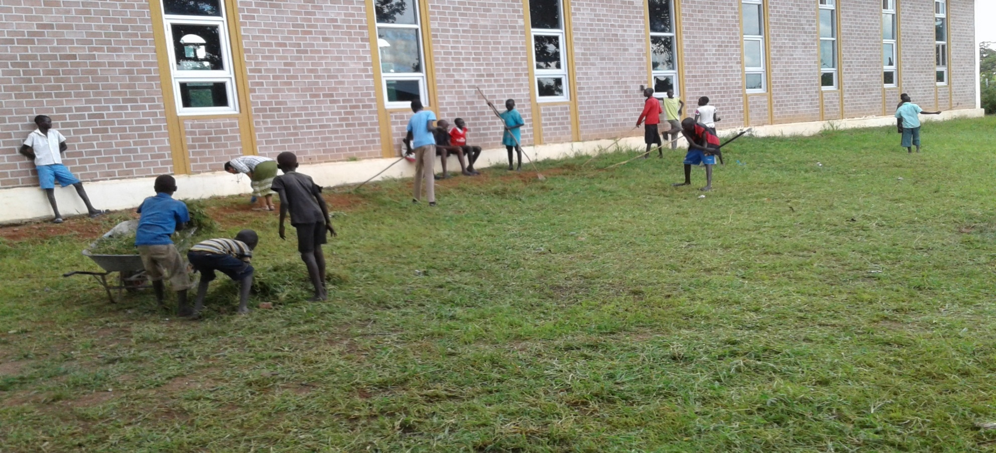
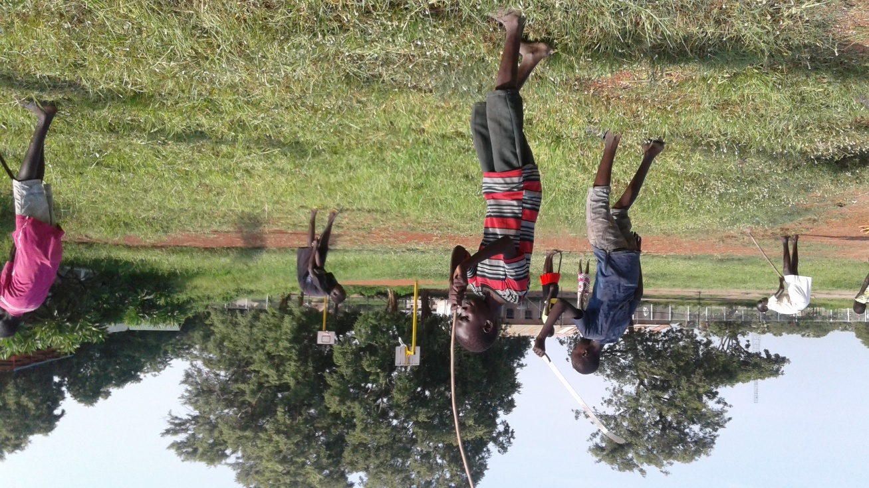
Missionary
Childhood
Association
Clearing the Parish Compound
Take care of our environment is one of their duties of de members of MCA

Slide 6
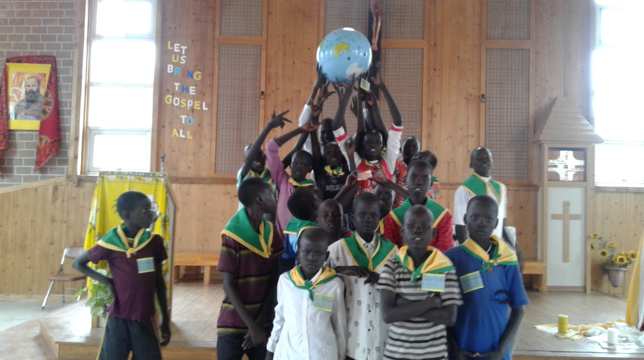
Let us protect our Mother
Earth

