Slide 1
The Congregation of the Sisters of the Sorrowful Mother
Title of Event:
Know Your Country Clean Up Tour.
A family event in preparation for the Season of Creation Month.
Place of Event:
Caroni Bird Sanctuary, Trinidad and Tobago, West indies.
Date of Event:
Sunday 12th August, 2018
Congregation Website
www.ssmgen.org
www.franinstitute.com
Presented by:
Sr. Julie Marie Peters, SSM;
Sr. Delia Monrose, SSM

Slide 2
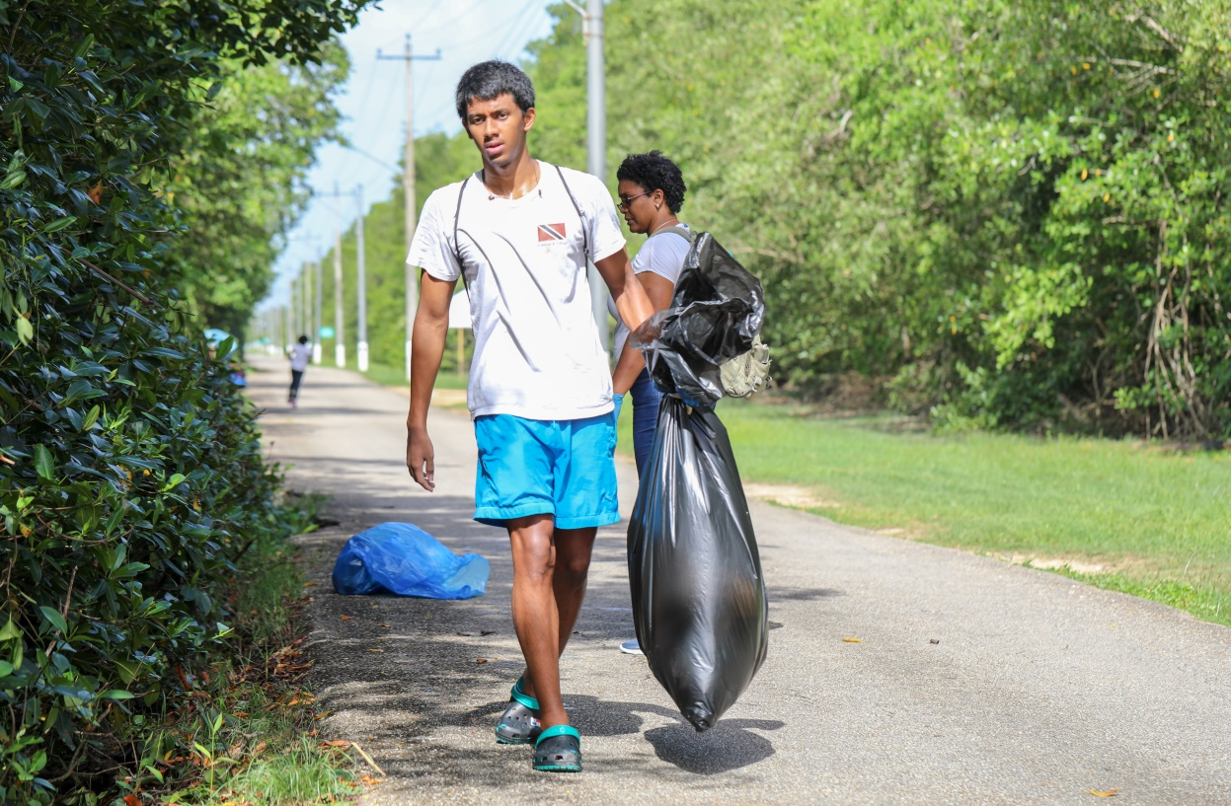
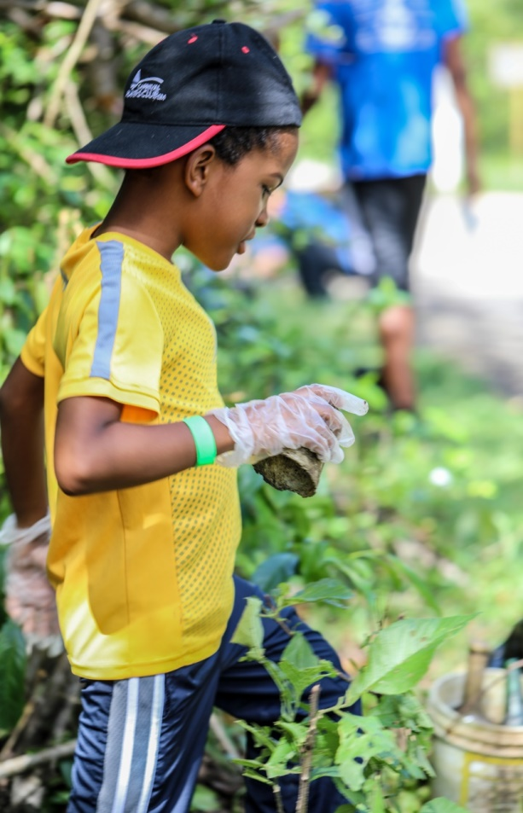
1. Mangrove Clean Up at the Caroni Bird Sanctuary
Students and families participated in a small clean up along the roadway and mangroves
School: St. Mary’s College, Port-of-Spain, Trinidad and Tobago, West Indies
Scouts; 6th Trinidad Sea Scouts from St. Mary’s College

Slide 3
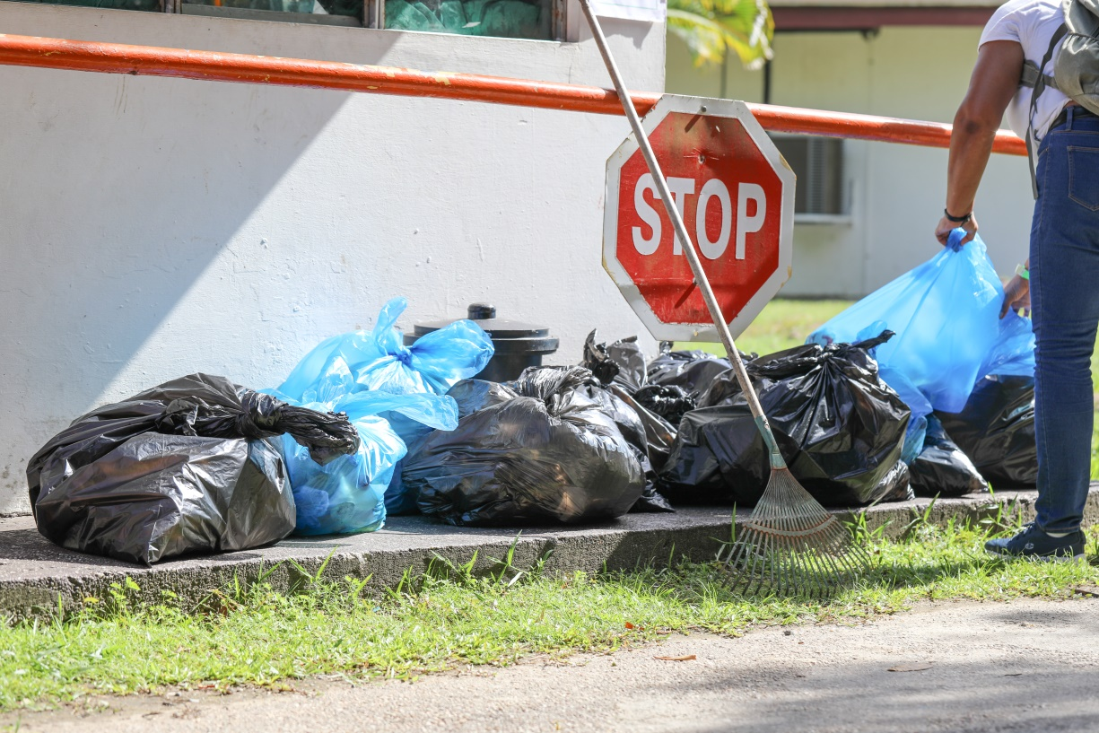
1. Mangrove Clean Up at the Caroni Bird Sanctuary
Families “Walking Together” at the clean up

Slide 4
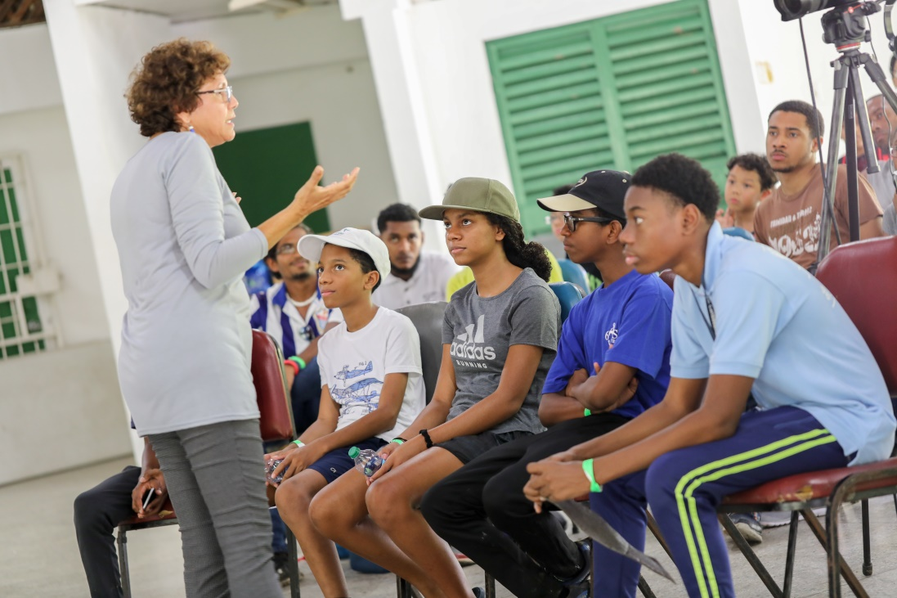
2. Non-Violence Towards the Earth: Our Home Talk Session
Representative of the Franciscan Institute for Personal and Family Development. A ministry of the Sisters of the Sorrowful Mother – Mrs. Nicole Gomes
Interactive Talk Session with the participants
Representative of the Sisters of the Sorrowful Mother -
Sr. Delia Monrose

Slide 5
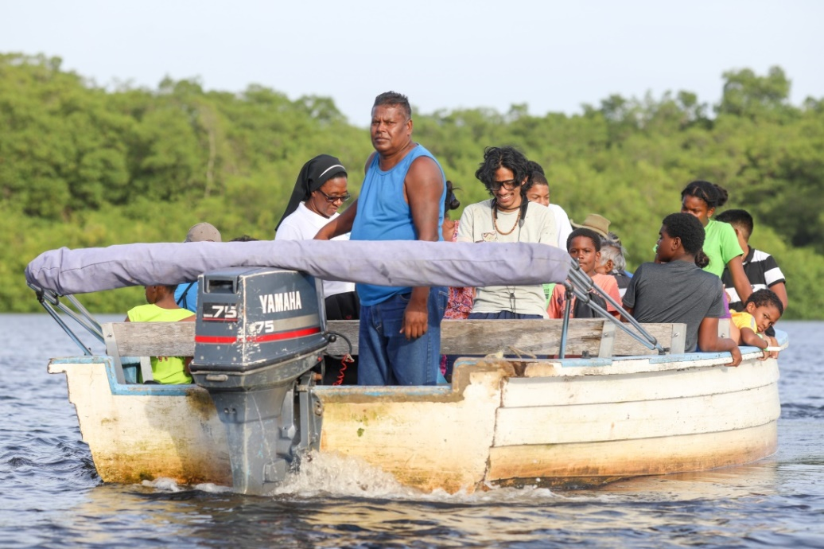
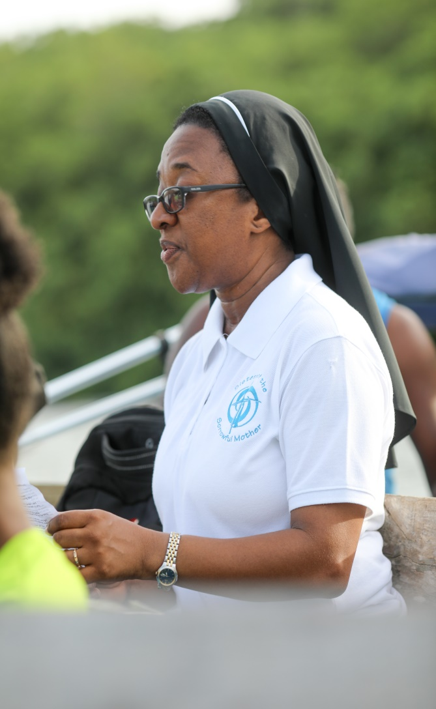
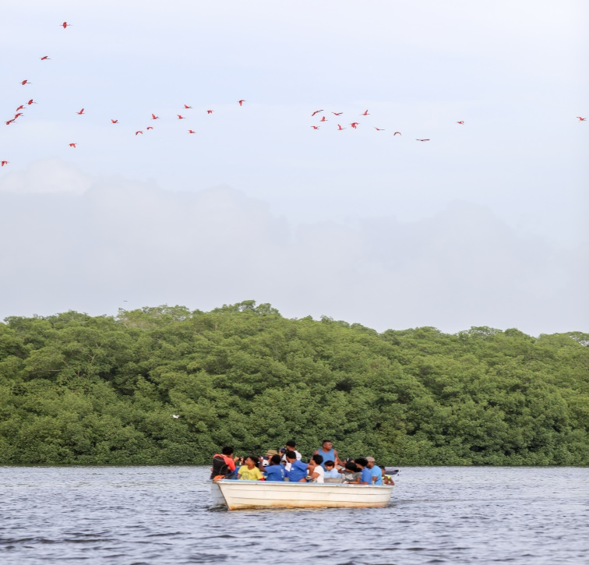
3. Boat Tour and Evening Prayer
Sr. Delia Monrose, SSM
conducted evening prayer with the participants during the
Caroni Bird Sanctuary Boat Tour

Slide 6
4. Student’s Feed back “Sowing Hope for the Planet”

Slide 7
The Congregation of the Sisters of the Sorrowful Mother supports the “Sowing Hope for the Planet”
THANK YOU For more information on this
Event Capture Report
please email team members:
Sr. Julie Marie Peters, SSM - ssmdaughter@gmail.com
Sr. Delia Monrose, SSM - srdeemarie@gmail.com
Margaret Johnston – institutefranciscan@gmail.com

