Slide 1
Going solar-
Ikwezi Rehabilitation decided on this project as of Mid February 2019. It is work in progress

Slide 2
Tree planting: Nine trees were planted in Glen Avent Convent in 2016-2017. The TPS involved in the international programme for final vows took part.

Slide 3
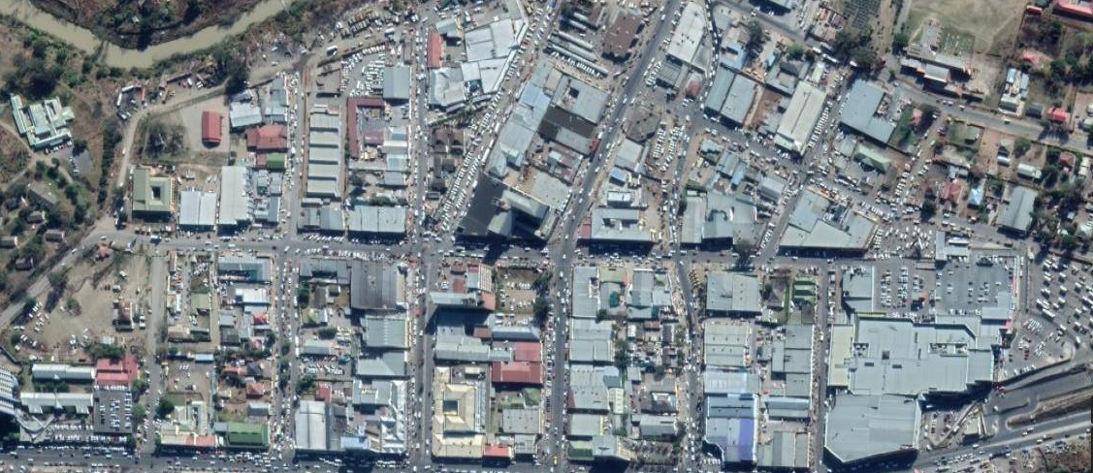
Interdenominational Campaign Cleaning Project
On Sunday 18th of November over 500 people responded to the call of the church to clean the Main Roads of Umtata.

Slide 4
Many people including some of our sisters were gathered in the main hall, dancing and singing. Refuse bags, brooms and spade were contributed by the municipality.

Slide 5
We cleaned the ground and city walls , removing abortion adverts & others that were not in the designated areas, full of energy with positive thoughts on how to care and keep the environment clean.

Slide 6
We helped each other in handling the garbage bags.

Slide 7
Even the Chief Shepherded of the flock , of Mthatha Diocese, Bishop Sthembele Sipuka next to Sr. Nokwanda was involved in the cleaning as well.

Slide 8
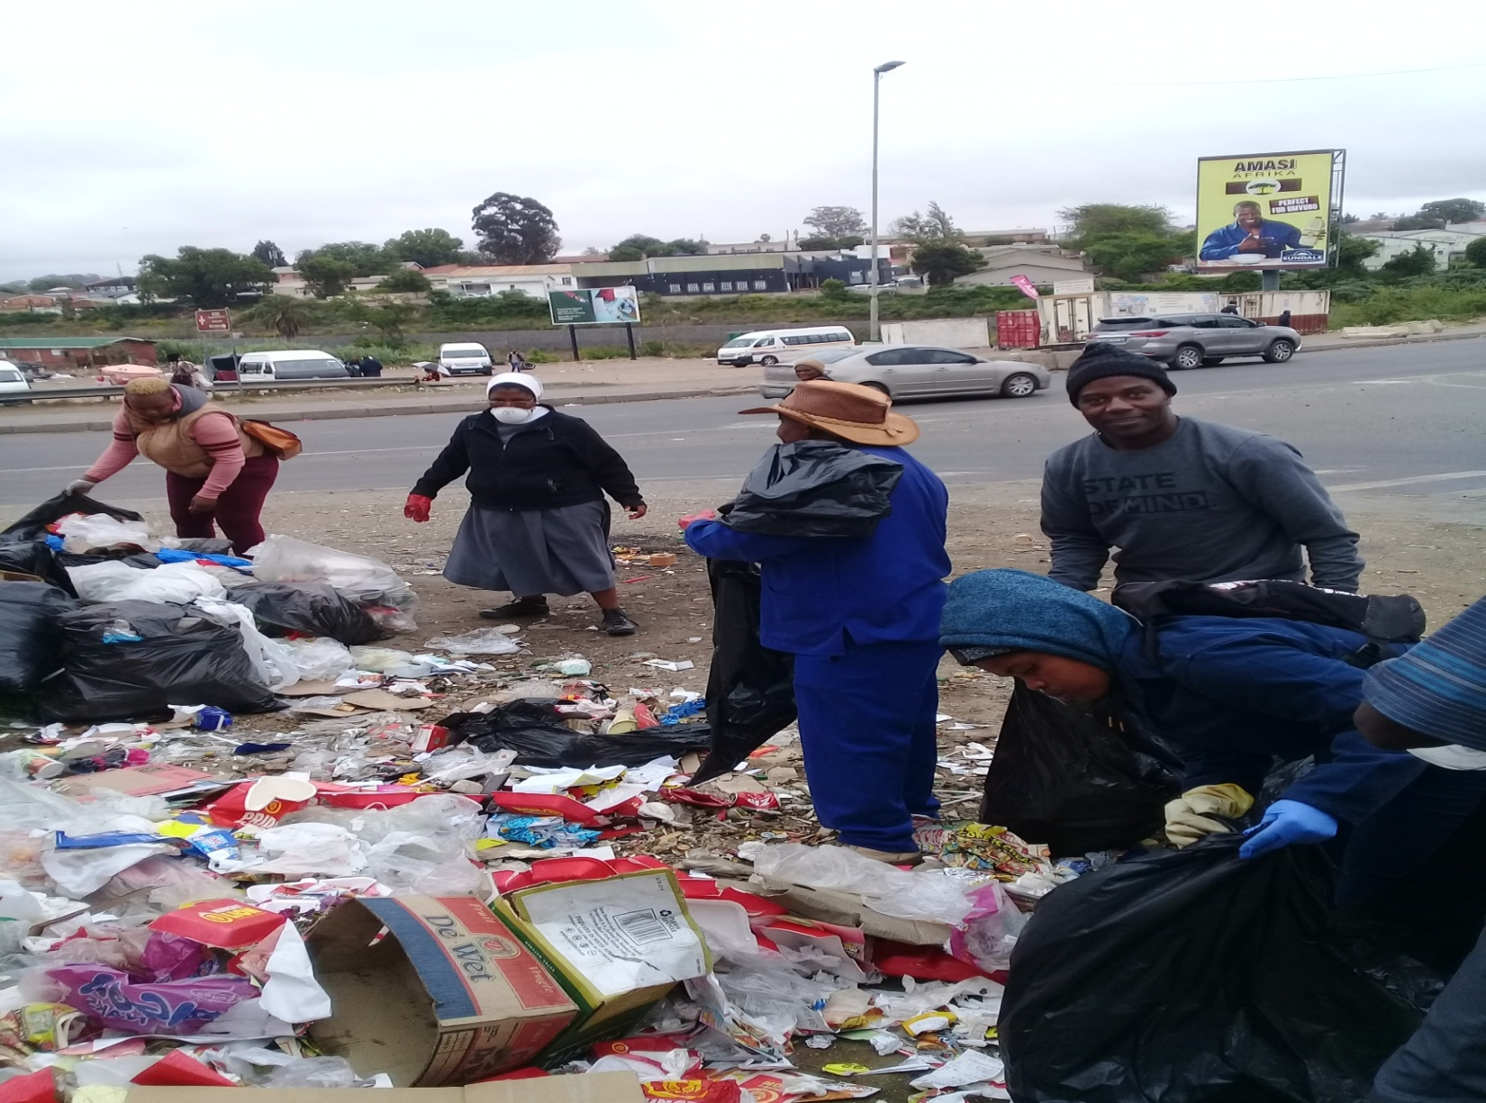
Some areas had heaps and heaps of garbage
that was not picked up

Slide 9
In some areas we had to segregate the waste, glasses and papers separately.

Slide 10
Priests and religious and residents worked together for keep Mthatha clean.

Slide 11
We then gathered the garbage into one sport for collection and disposal by the waste truck.

Slide 12
We were so glad that we took part, to make a sign and make a start. It was a wonderful success with all the people present. May God bless!

Slide 13
Almost done in good spirit as Sr. Pauline and Sr. Cecilia felt that a good job was done.

Slide 14
At the end of the three hour-cleaning, the congregation was challenged with the message from our Bishop Sipuka that we need to make it our personal responsibility to care for our environment at all times.

Slide 15
Fially all is well. Mthatha was very clean. We hoped to keep it that way!

