Slide 1
Pope John XX111
It is impossible for wealthy nations to look with indifference upon the hunger, misery and poverty of other nations...it is nothing less than an outrage of justice and humanity to destroy goods that other people need for their daily lives
John XXIII (1961)Mater et Magistra ,157,161

Slide 2
Pope Paul V1
...by an ill-considered exploitation of nature (man) risks destroying it and becoming in his turn the victim of this degradation...... thus creating an environment for tomorrow which may well be intolerable. This is a wide-ranging social problem which concerns the entire human family.
Paul VI 1971- 80th anniversary of Rerum Novarum

Slide 3

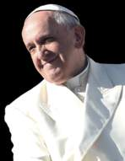

Ecology
Environment, Nature & Society

Slide 4


RELATIONSHIP

Slide 5
With
God
‘God created man in the image of God he created him, male and female he created them’ Gen 1:27
‘God saw all that he had made, and indeed it was very good’ Gen 1:31
‘Before I formed you in the
womb and I knew you’ Jer. 1:5
(65)

Slide 6

With
Others
I urgently appeal for a new
dialogue about how we are
shaping the future of our planet
All of us can cooperate for the
care of creation, each according to his or her own culture, experience, involvements and talents (14)

Slide 7
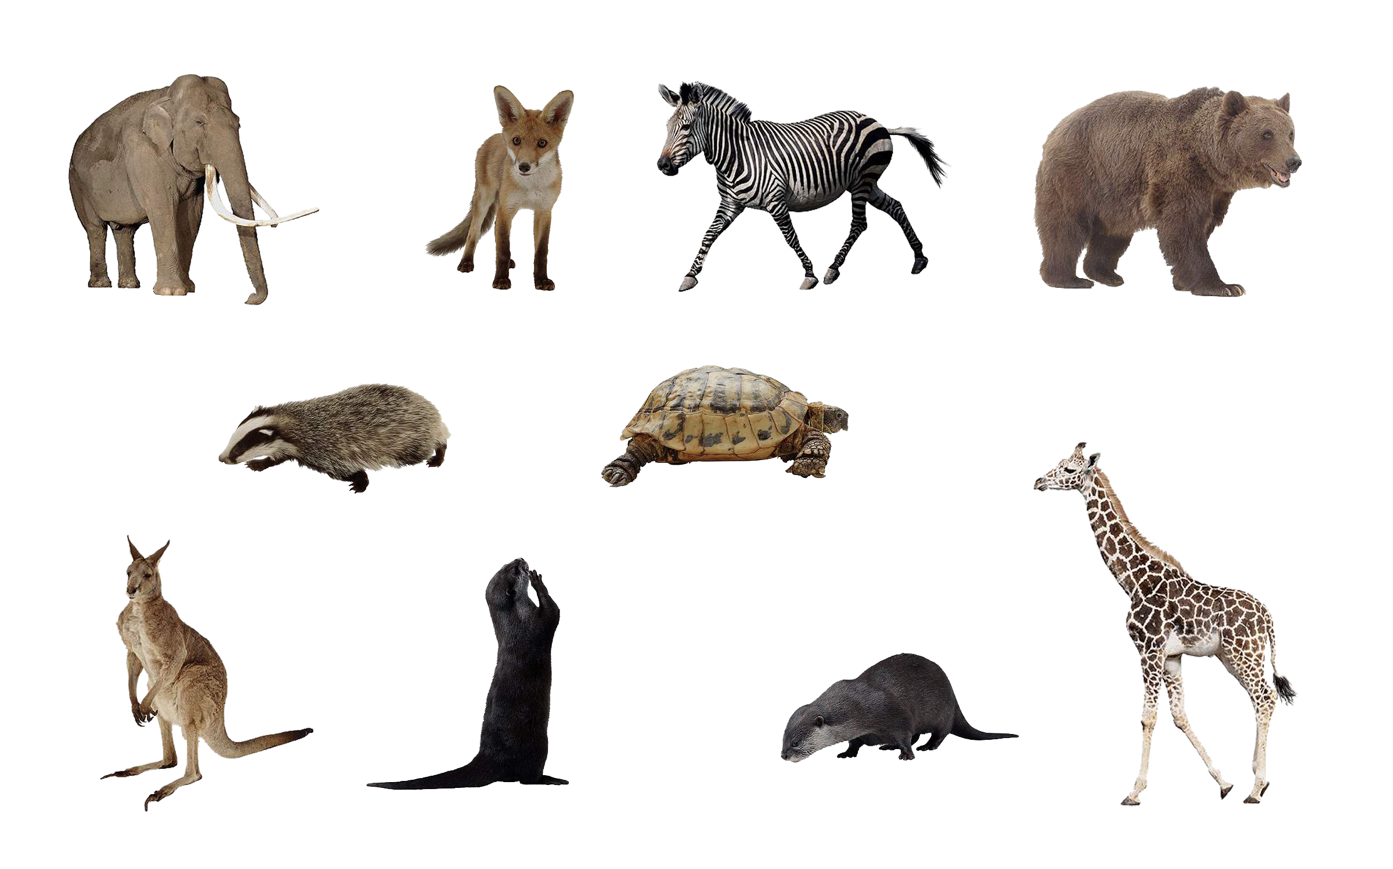
With the
community
of life
Everything is related, and we human beings are united as brothers and sisters on a wonderful pilgrimage, woven together by the love God has for each of his creatures (92)

Slide 8
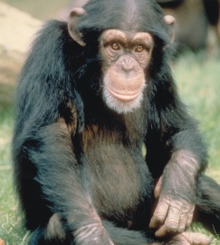

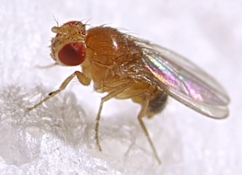
Humans share the planet with as many as 8.7 million different forms of life...
A chimpanzee? | 96% - Chimpanzees are the closest living species to humans.
A mouse? | 85% - All mammals are quite similar genetically.
A fruit fly? | 44% - Studies of fruit flies have shown how shared genes govern the growth and structure of both insects and mammals.

Slide 9
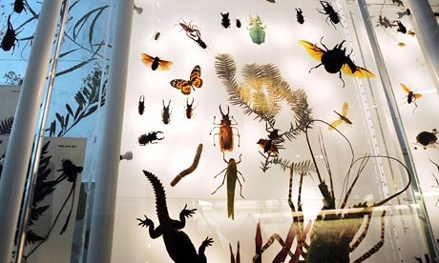
Three-quarters of the 8.7m species – the majority of which are insects – are on land; only one-quarter, 2.2m, are in the deep, even though 70% of the Earth's surface is water.
Camilo Mora - The University of Hawaii

Slide 10
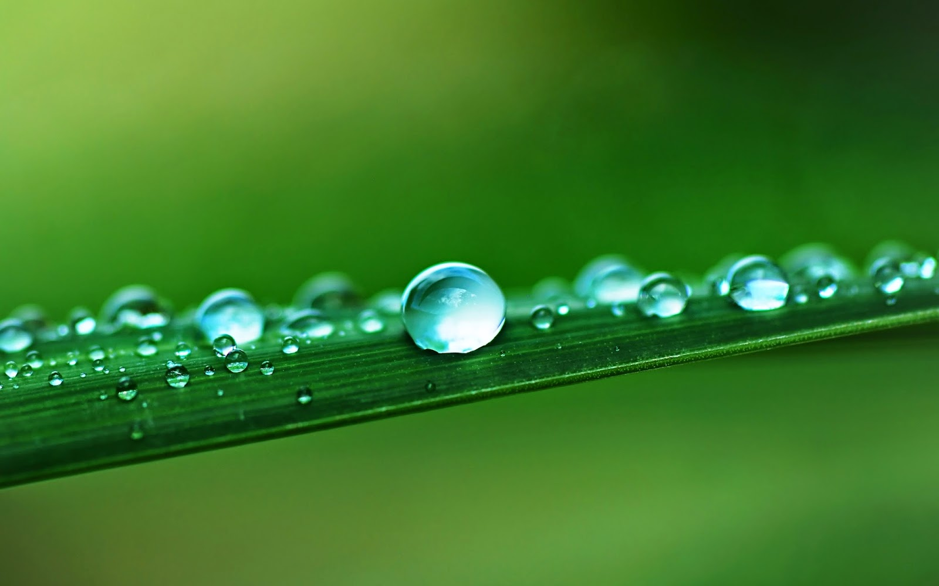
...environmental problems cannot be separated from how individuals relate to themselves which leads in turn to how they relate to others and to the environment (141)
In harmony with nature
When we speak of the environment, what we really mean is a relationship existing between nature and the society which lives in it (139)

Slide 11
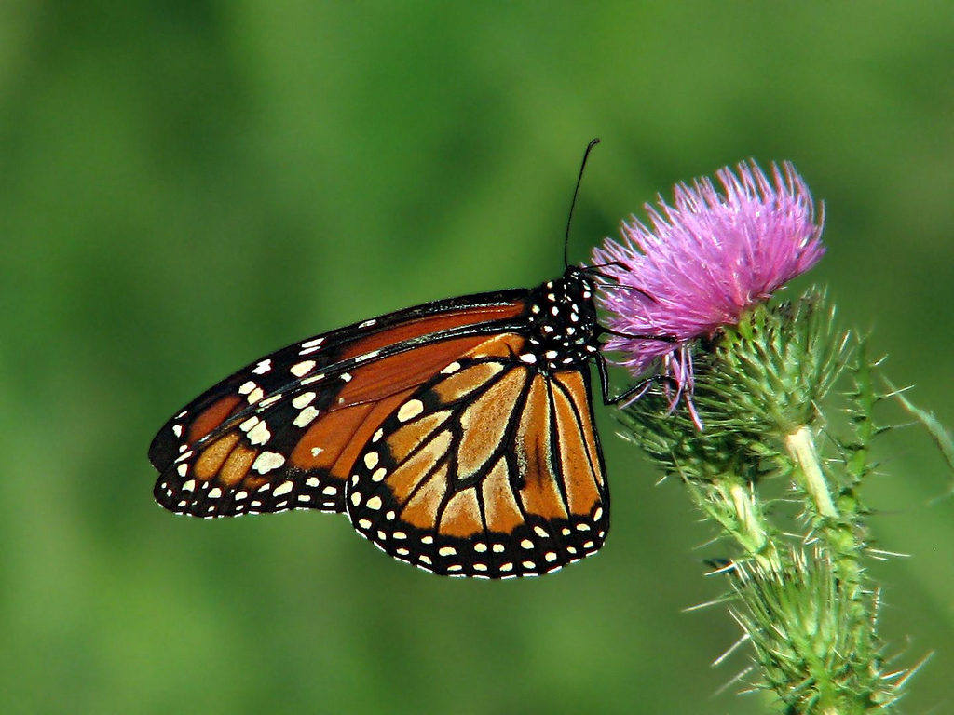
We are the food we eat, the water we drink, the air we breathe and reclaiming democratic control over our food and water and ecological survival is the necessary project for our freedom – Vandana Shiva

Slide 12

With the
Present
All Christian communities have an important role to play in ecological education (214)
The rich heritage of Christian spirituality has a precious contribution to make to the renewal of humanity (216)

Slide 13
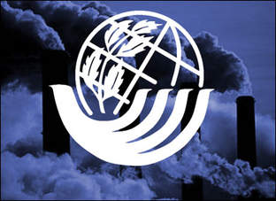
... asks us to leave behind a period of self-destruction and make a new start, but we have not as yet a universal awareness needed to achieve this (207)
Earth Charter...

Slide 14
War always does grave harm to the cultural riches of peoples....politics must pay greater attention to foreseeing new conflicts and addressing the causes...but powerful financial interests prove most resistant to this effort (61)

Slide 15
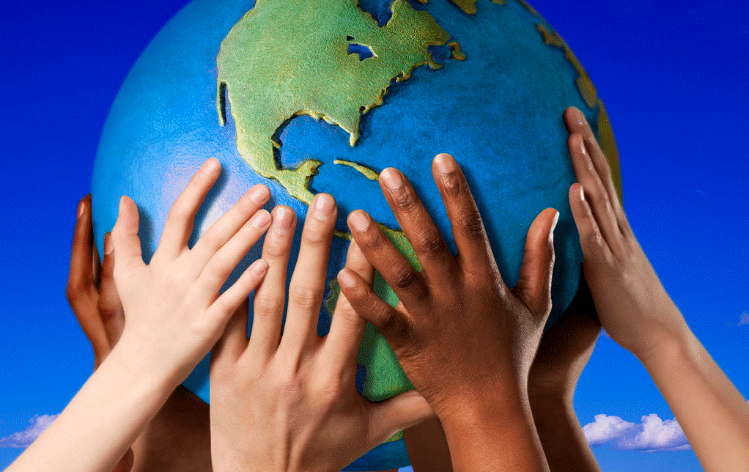
‘ecological education’
‘renewal of humanity’

Slide 16

With the
Future
Given the complexity of the ecological
crisis, we need to realise that the solutions
will not emerge from just one way of
interpreting and transforming reality (63)

Slide 17

I urgently appeal for a new dialogue about how we are shaping the future of our planet (14)

Slide 18
Global Issues
Food
Up to 40 percent of all cropland worldwide is experiencing soil erosion, reduced fertility, or overgrazing.-70% of all fresh water is used for irrigation -UN
Many major rivers—including the Colorado, Ganges, Indus, Rio Grande, and Yellow—are so over-tapped that they now run dry for part of the year. Freshwater wetlands have shrunk by about half worldwide. -UN
Water
The coexistence of substantial military spending with unmet human needs has long evoked concern. President Eisenhower- 'every gun that is made, every warship launched, every rocket fired represents, in the final analysis, a theft from those who hunger and are not fed, who are cold and are not clothed'
Peace

