Slide 1
SEWING HOPE FOR THE PLANET

Slide 2
“HOPE FOR THE PLANET”
The Precious Blood Convent Mariannhill, South Africa.

Slide 3
Program :
“BIOLOGIC ONION-GARLICK PESTCONTROL METHOD”.
The basic aim of our Program is to reduce the use of toxic chemicals on our garden and field- products.

Slide 4
Healthier living by recycling basic kitchen waste to a biological insecticide since toxic chemicals, such as monophosphates and many others which are components of most of the commercially acquired pest control items are known to be hepatotoxic and or carcinogenic, i.e. toxic to the liver or cause cancer.
Protecting the ecology of nature, by using this biological
Pest control (e.g. birds and insects) which are killed by the use of toxic components.
Prevention of water- pollution is also an important point to be remembered where toxic chemicals are used in gardens or fields.

Slide 5
From the commercial point of view this will reduce the market - production of pesticides, and insecticides..
Onion-Garlick spray is also effective for fungal infestation. It is particularly useful on tomatoes when used in good time, that is before they are infested. The point to start treatment is when tomatoes begin to flower. Spraying the plants should be done initially at 2-3 days intervals

Slide 6
The method of our biologic insecticide is simple. The originals recipe is as follows:

Slide 7
Chop 5 large onions into small pieces, add 5 litres of water, keep for 5 days by occasional stirring, then crush 5 cloves of garlick and add. Stir well and keep another day. Then filter it. The filtrate can be diluted 1/10 for use of spraying directly on to the plants or for watering the plants or both. Watering young seedlings protects them 100% from cutworms and other harmful insects or pests.

Slide 8
We have started a somewhat modified method. We collect all the onion wastes from the kitchen, also the peals,- add water and place them into a drum and keep the drum (for weeks on end) until it is full with these remnants. Occasional stirring is needed.

Slide 9
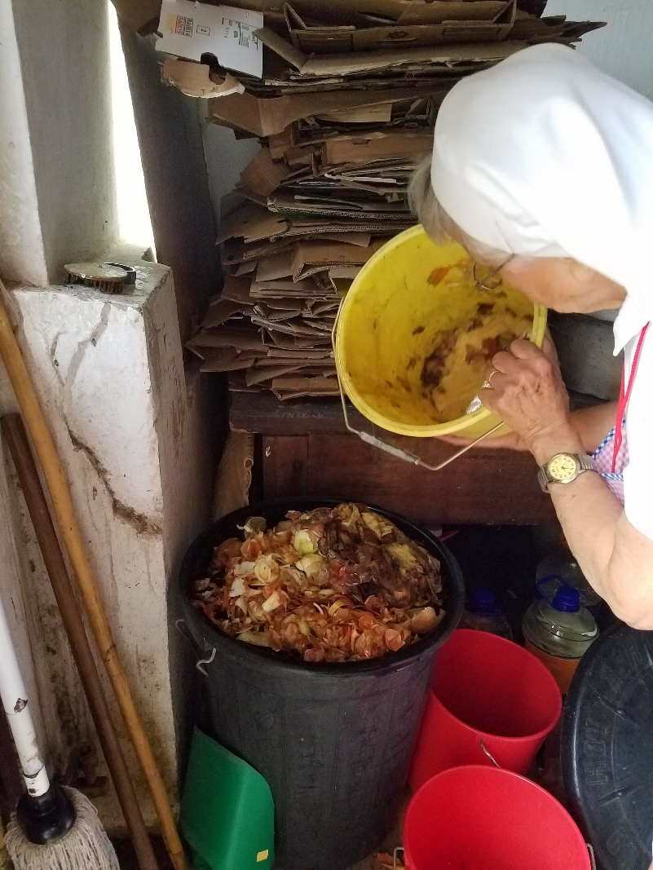
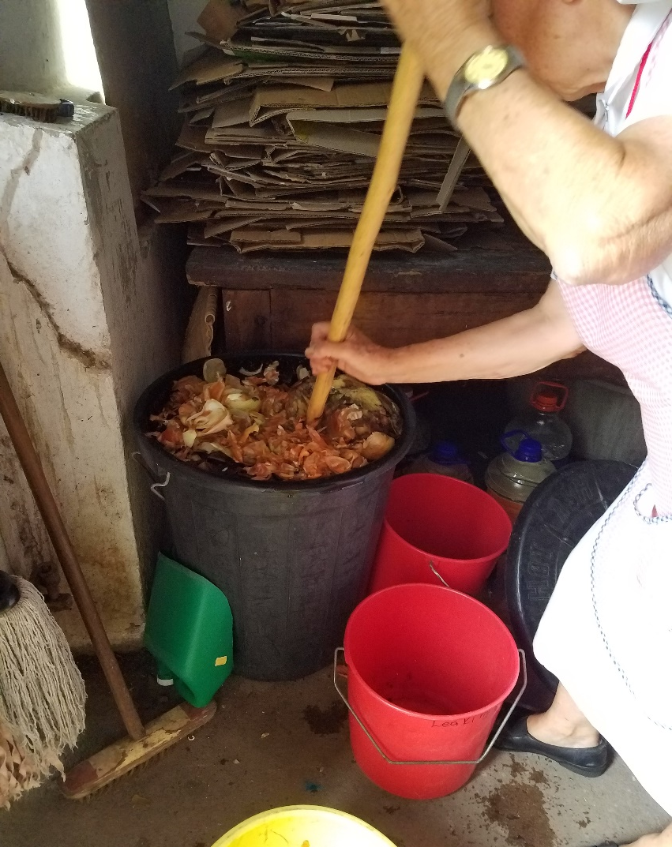
Onion Peels Collected from the Kitchen
Collection Drum to which water is added
Occasional Stirring is necessary

Slide 10
Before we filter it we add 5 whole crushed garlick (this can easily be done with a stone or brick), then added to the drum.
After another 2-3 days, we filter it and store the filtrate in 5 litre cans.
This filtrate can again be diluted at least 1/10 or 1/20 for watering or spraying.

Slide 11
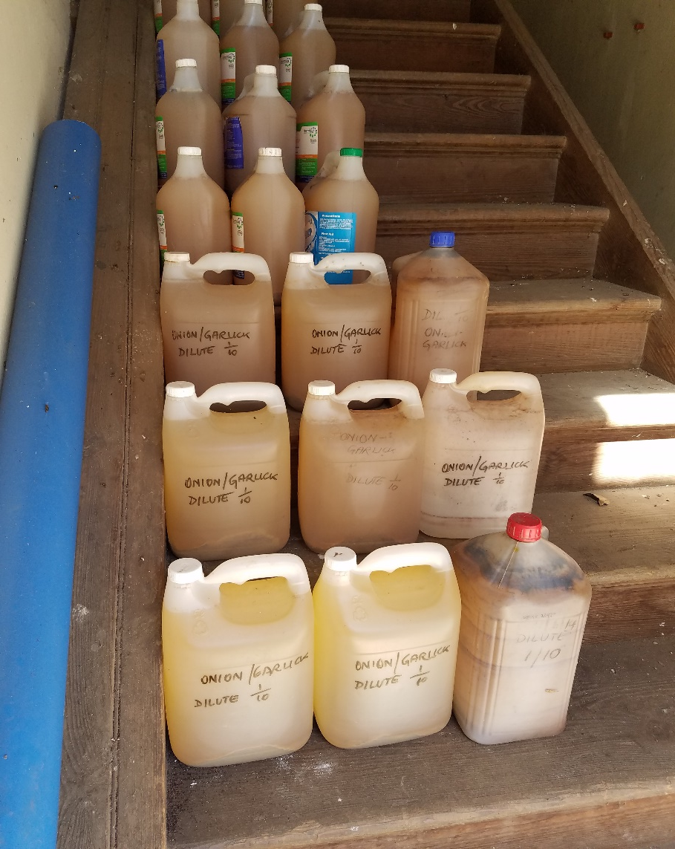
Storing the filtrate in 5Litre bottles.

Slide 12
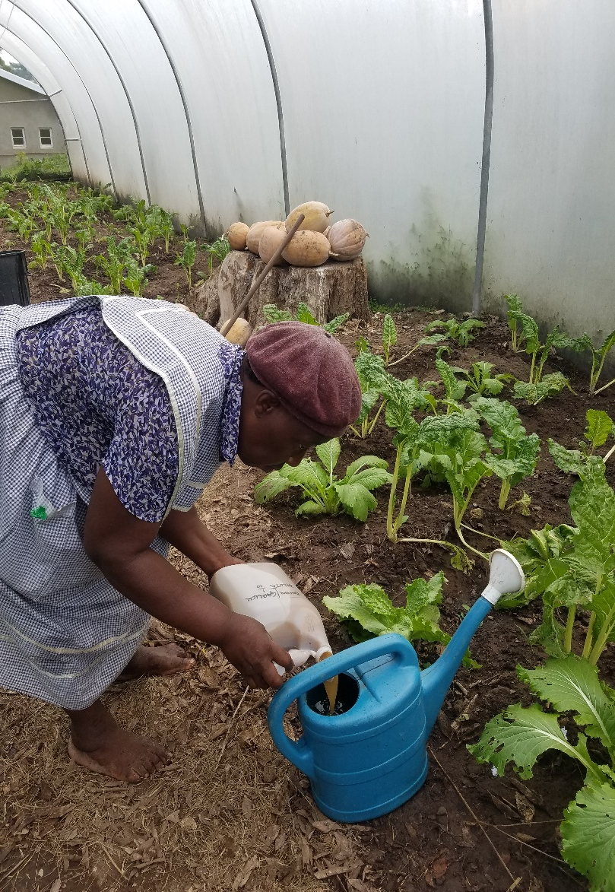
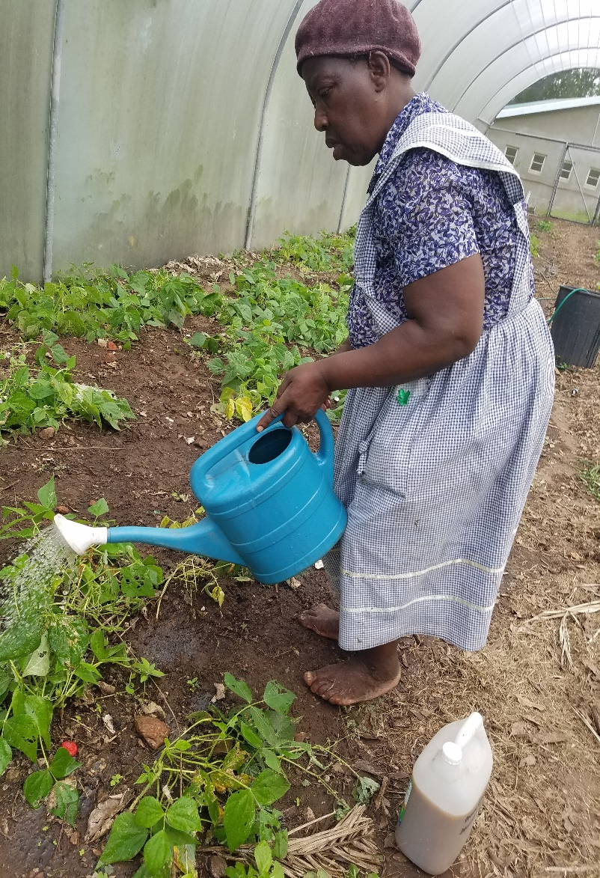
Mixing
Measuring
Watering

Slide 13
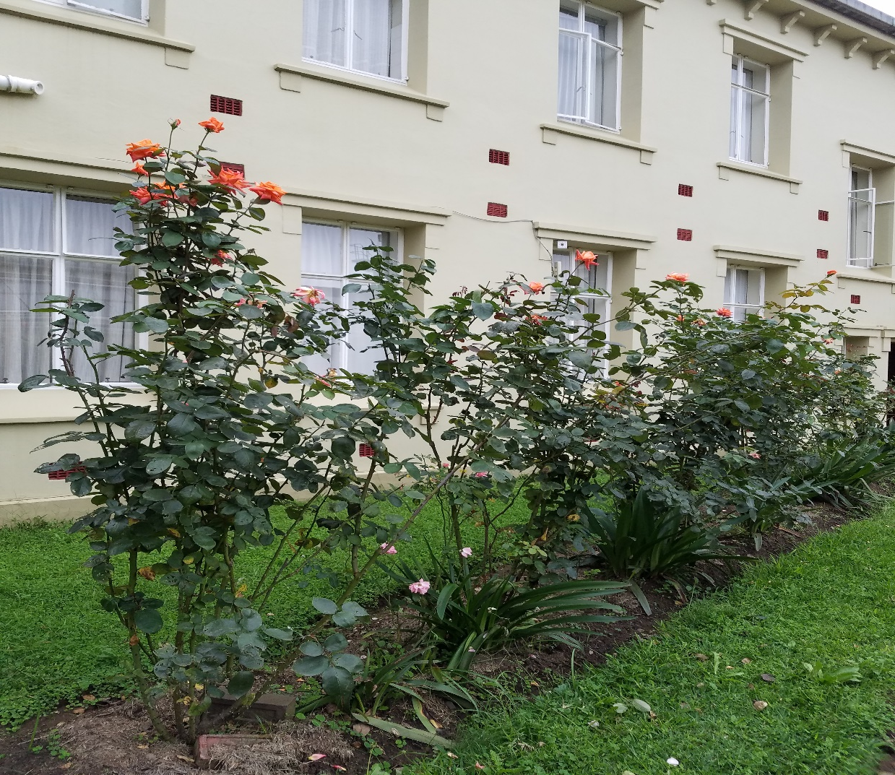
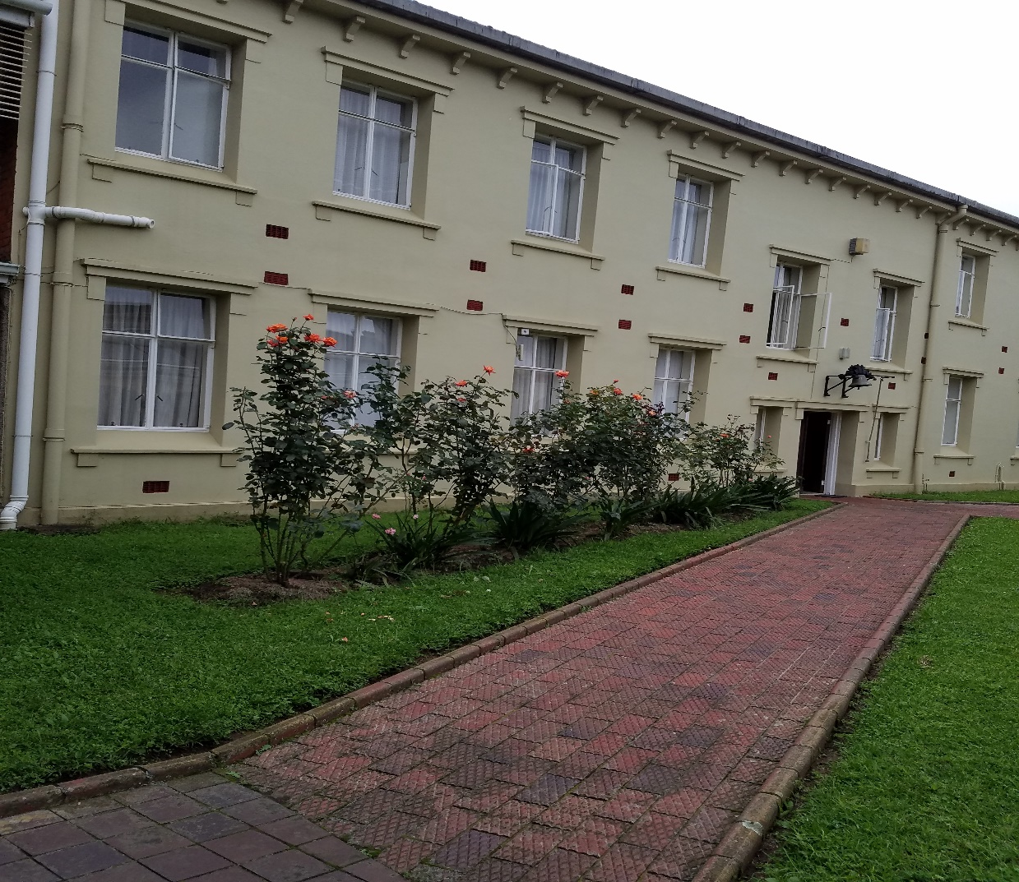
The roses in our convent yard, now fully alive and flowering abundantly after watering every 2 weeks with Onion-garlick to get rid of the termites.

Slide 14
Recommendation
From personal experience we now know that watering with Onion-Garlick has been 100% effective against the termites which were killing our rose-bushes in the yard.
A little amount of fertilizer with this ‘onion-garlick ‘watering was but also added and now all admire our roses.

Slide 15
Conclusion
The above method is so easy, though also a bit massy when it comes to filtering.
The smell of it some sisters do not appreciate. We know it is 100% safe and effective.

Slide 16
END!!

