Slide 1
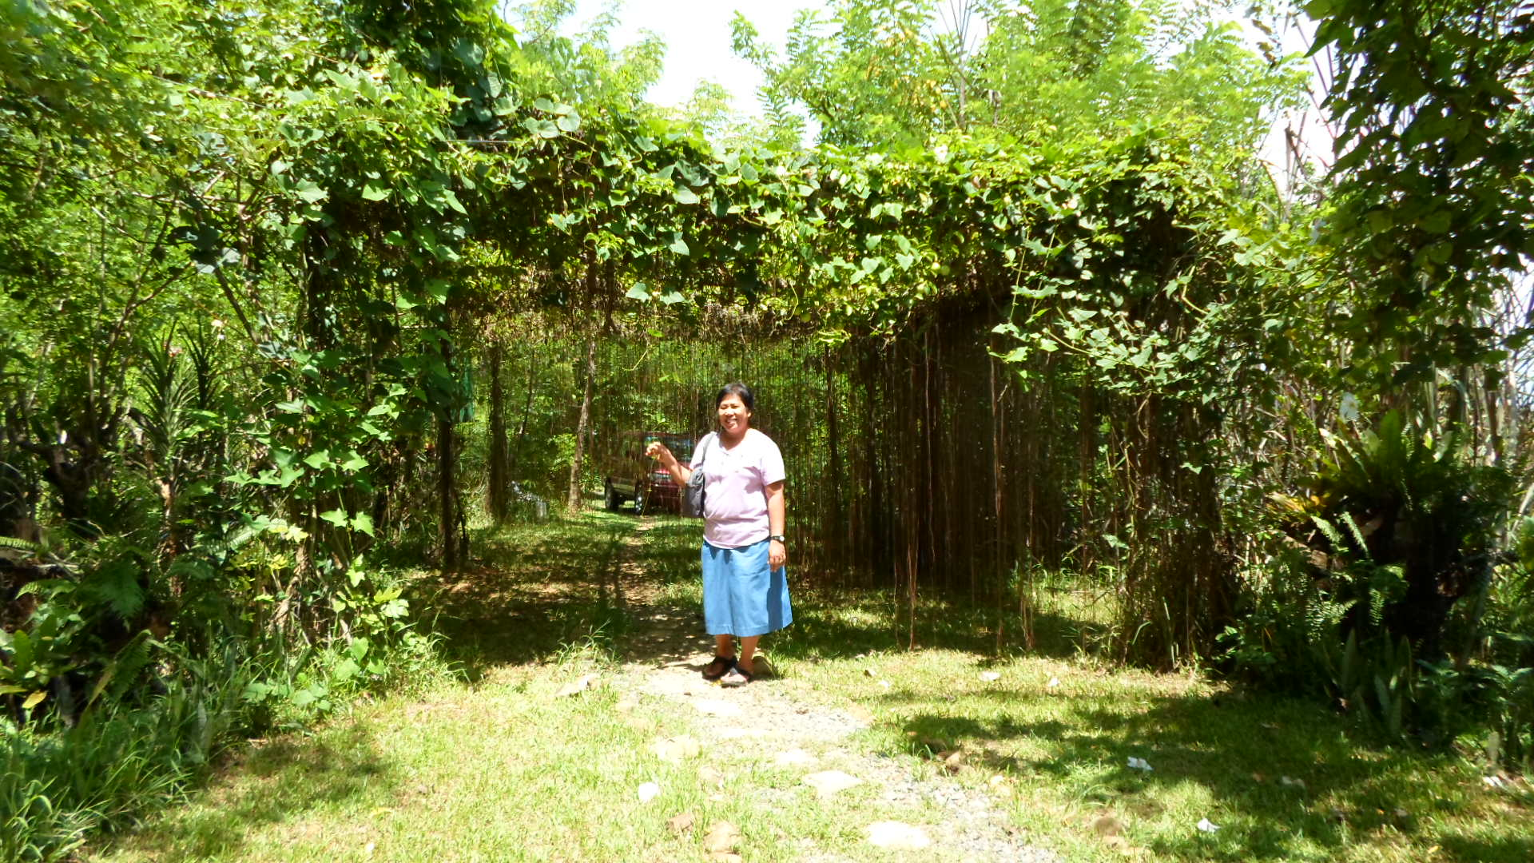
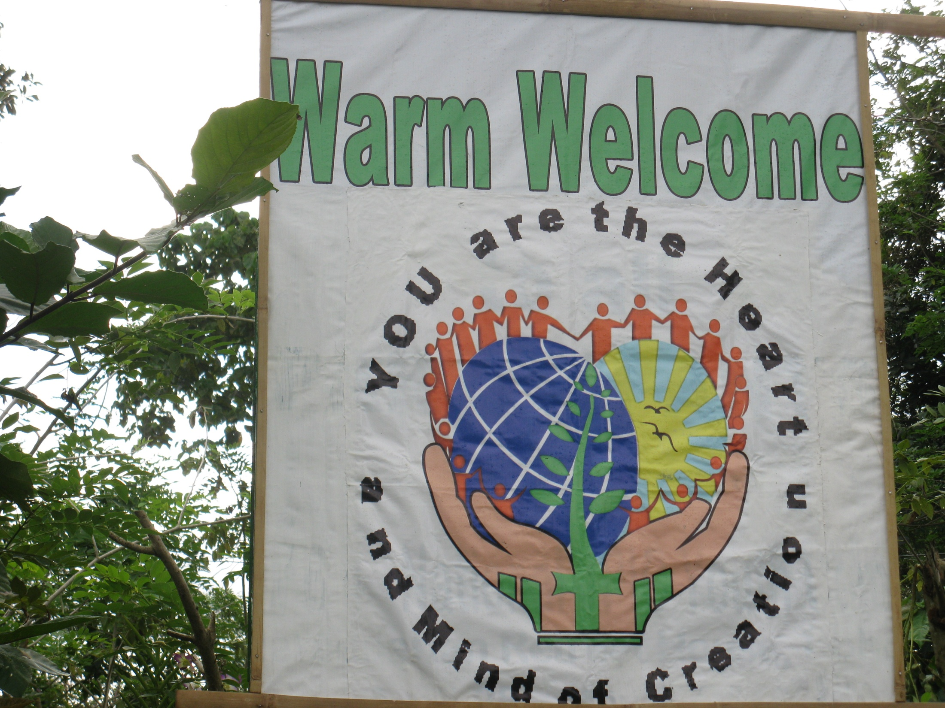
C.A.R.E.S.
Community Awareness to
Restore Earth System

Slide 2
TO
Warm WELCOME
COMMUNITY OF LIFE

Slide 3
Community
We form a COMMUNITY who commit ourselves to care, to restore the Earth System and to form part of the COMMUNITY Of life.
Community Awareness to Restore Earth System

Slide 4
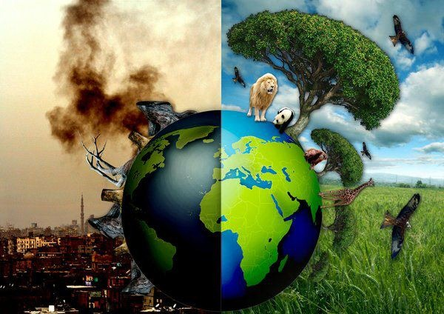
Awareness
We are aware and want to help our fellow humans to be AWARE and CONSCIOUS of the
grave destruction done to our Mother Earth and
our contribution to this continuing devastation.
Community Awareness to Restore Earth System

Slide 6
to Restore the Earth System
We believe that GOD created the Earth and the Universe with a SYSTEM.
Community Awareness to Restore the Earth System

Slide 7
Earth System
Atmosphere
Hydrosphere
Includes mixture of gases that surround the planet
Includes oceans, lakes, rivers, ground water, ice, water vapor
Geosphere
Biosphere
Includes the crust, mantle, inner & outer core
Includes all living things: plants, animals, other organisms

Slide 8
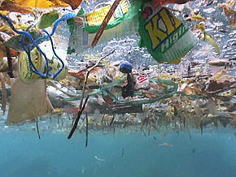
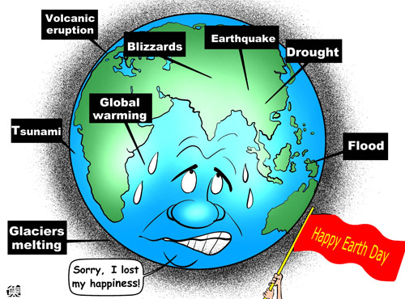
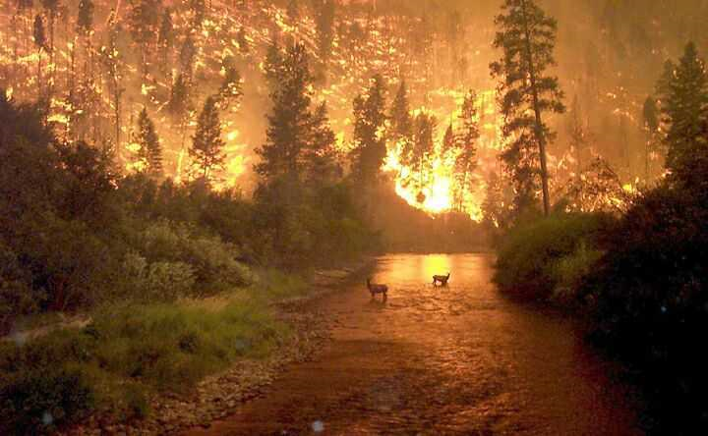
But we humans have destroyed it in the name of “Progress and Development.”

Slide 9
to Restore the Earth System
Our Mission is to be responsible stewards to restore the Earth System as planned by GOD
Community Awareness to Restore the Earth System

Slide 10
YES!

Slide 11
As an institute of Mercedarian Missionaries of Bérriz, with our Lay partners…
We celebrate this Extraordinary Jubilee of Mercy by
living out MERCY for our Mother Earth and for one another in this Community of Life and
liberating her from the chains of human exploitation and destruction.

Slide 12
CARES Development Concept
A design system for ecological and sustainable living, integrating plants, animals, people, building and community

Slide 13
Therefore, in CARES…
Zones 1- 6 are designed and interconnected with each other to create alternative, sustainable food growing and for the wellness of the whole COMMUNITY of LIFE
and how we as human beings can live interdependently with all of God’s creation, our Earth and Universe, using wisely Mother Earth’s limited resources…

Slide 14
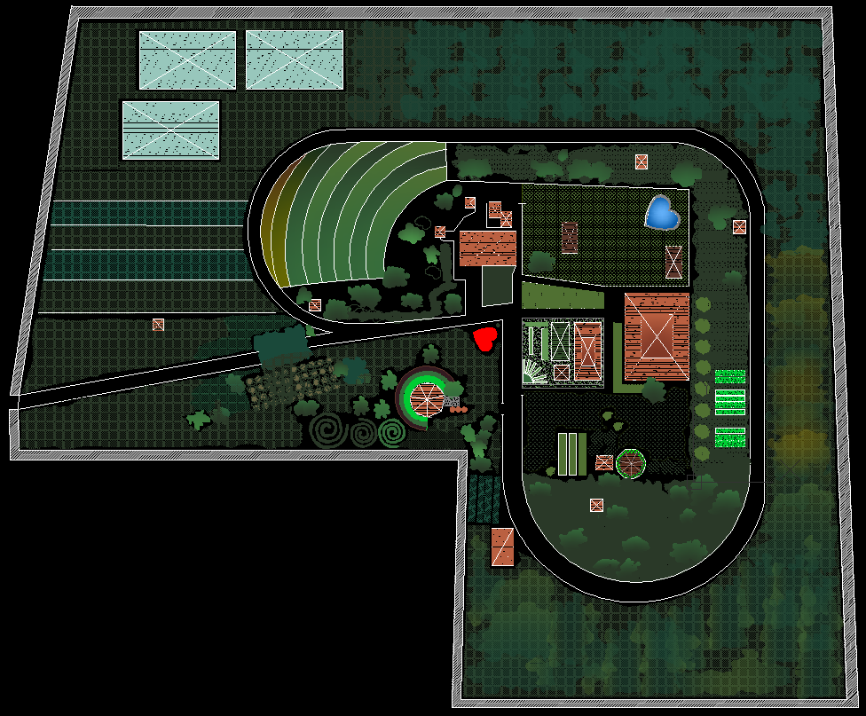
ZONE 6
AQUAPHONICS
We are here
ZONE 5
ZONE 3
WILDLIFE: FOREST
HERBAL & FLOWERING PLANTS
ZONE 1
VEGETABLES
ZONE 2
ZONE 4
LIVESTOCK
FRUIT TREES

Slide 15
As guests in this our “COMMON HOME,” we invite you to -
cooperate in restoring
Our
EARTH
SYSTEM
during your stay here.
The Earth System

Slide 16
CARES: Smoke-Free Zone
To keep the air that we breathe fresh and clean

Slide 17
CARES:

Slide 18
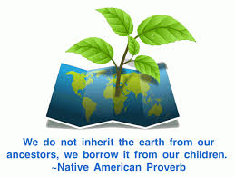
What is Zero Waste?
Change our lifestyle by reducing waste volume and toxicity of waste and materials.
Recognize that one’s person’s trash is another’s treasure.
Recognize that all materials are resources.

Slide 20
“What comes from the earth, goes back to the earth.”
CARES does not have basurahan, so kindly bring your non-biodegradables back with you such as –
Plastics, tin foils…

Slide 21
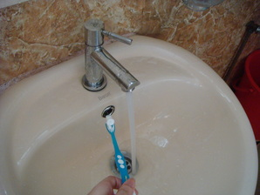
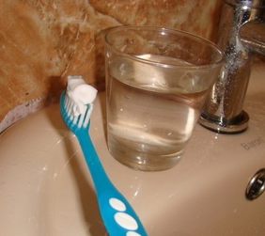
CARES conserves water
NO to wasting 5 liters of water per minute while brushing your teeth
YES to saving up to 8 gallons of water a day when you use a glass to brush your teeth

Slide 22
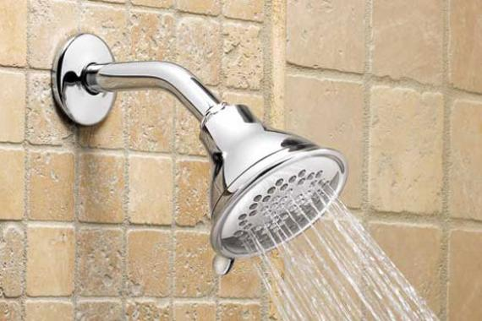
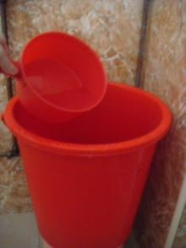
CARES: conserve water
Up to 7 gallons of water is used every minute that the showerhead is running… wasted down the pipe.
And I can CHOOSE to use the pail to save water – a precious limited resource of Mother Earth.
The CHOICE is yours!!

Slide 23
CARES conserves water
Our Request is
To use as less water as possible when you shower or when you bathe.
Usually, half a pail is enough for taking a bath.
A pail-full or a bit more is needed when you wash your hair.

Slide 24
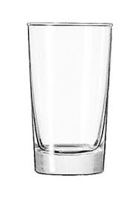
CARES conserves water
If you do not have a water bottle, We Request that -
You please hold on to your glass for the whole day…
And kindly finish the water in your glass when you drink…

Slide 25
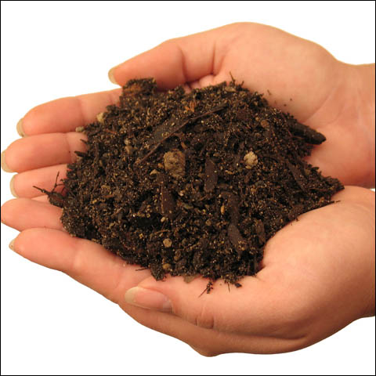
CARES: protects our soil
The WATER that we use to wash our hands and bodies goes back to the earth tenderly and gently… to be REUSED and RECYCLED by the earth system…

Slide 26
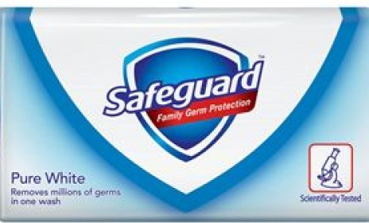
CARES: protects our soil
Therefore, we REFUSE… Germicidal soap since they kill the bacteria, microorganisms that are in the soil
Only biodegradable or herbal soap are allowed…

Slide 27
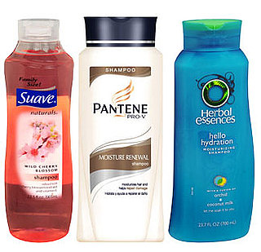
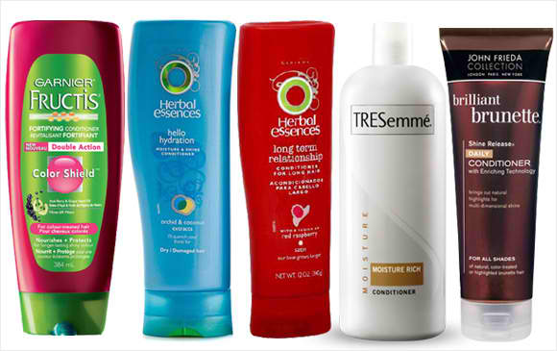
CARES protects our soil
We REFUSE… the use of shampoo that contains phthalate, sulfate, silicon and paraben, PEGS, ALS/ALES, SLS/SLES… since these are harmful chemicals that poison our soil.
Only organic, natural or herbal shampoo are allowed…
Notes:
(ammonium lauryl sulfate / ammonium laureth sulfate)
1. SLS or SLES (sodium lauryl sulfate and its gentler form sodium lauryl ether sulfate) 2. ALS or ALES (ammonium lauryl sulfate and its gentler ..

Slide 28
Mabuhay Kalikasan Store
Sells some products that are eco-friendly and not destructive to our soil and to us humans if you need…

Slide 29
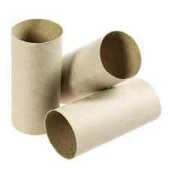
CARES recycle -
Please do not throw these toilet paper core in the trash cans that are inside the toilets.
These are only for the feminine sanitary napkins. For Ladies, kindly wrapped them with the newspaper that are provided for.

Slide 30
In CARES,

Slide 31
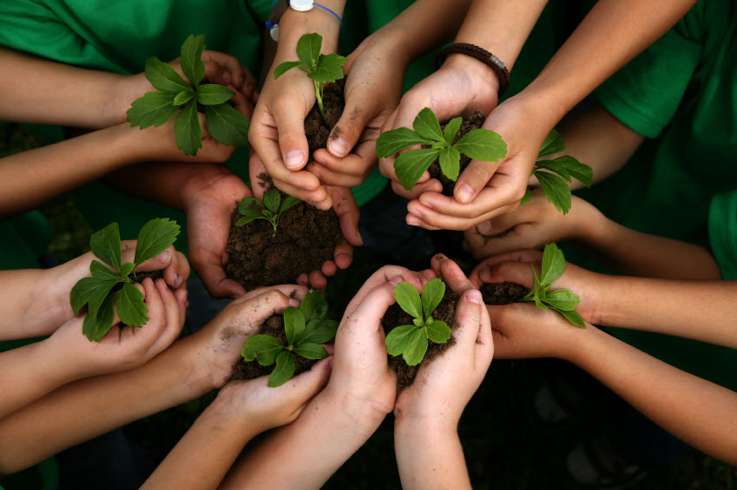
And Earth Care: is part of our daily schedule as our simple way to say “THANK YOU” to Mother Earth who always provides us with food, water… all that we need for physical health

Slide 32
CARES saves ENERGY
We need your COOPERATION to turn off lights when not in use
If you need to CHARGE your cell phones and other gadgets, kindly give a donation of at least PhP20

Slide 33
CARES at your service
If you have special diet or some food allergy, kindly inform us.

Slide 34
CARES at your service
Any other questions???
If you need anything, Please do not hesitate to inform anyone of the Staff members around to help you.

Slide 35
Maraming Salamat po! Thank you very much!
Together with the whole CARES Community of Life,
Welcome and wishing you a growing AWARENESS and passionate fruitful COMMITMENT to restore earth system!!

